Slide 1
Kubernetes
Kubernetes Up & Running
Part IV
2026.08.25

Slide 2
DaemonSets

Slide 3
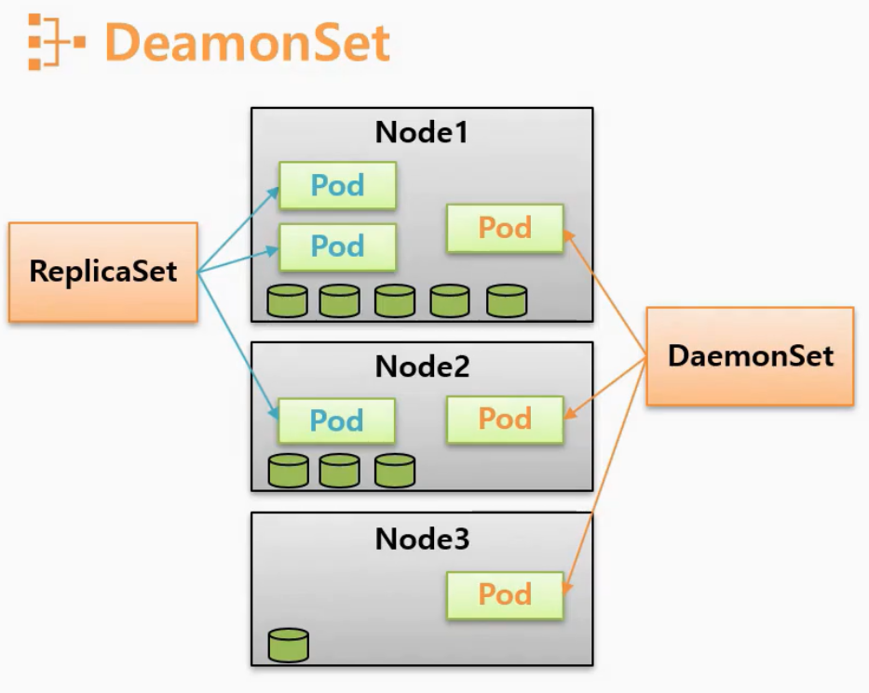
Introduction(1/2)
What is DeamonSet? :
  Deployments and ReplicaSets are generally about creating a service (e.g., a web server) with multiple replicas for redundancy. But that is not the only reason you may want to replicate a set of Pods within a cluster. Another reason to replicate a set of Pods is to schedule a single Pod on every node within the cluster. Generally, the motivation for replicating a Pod to every node is to land some sort of agent or daemon on each node, and the Kubernetes object for achieving this is the DaemonSet.
  A DaemonSet ensures a copy of a Pod is running across a set of nodes in a Kubernetes cluster. DaemonSets are used to deploy system daemons such as “log collectors” and “monitoring agents”, which typically must run on every node. DaemonSets share similar functionality with ReplicaSets; both create Pods that are expected to be long-running services and ensure that the desired state and the observed state of the cluster match.
  Given the similarities between DaemonSets and ReplicaSets, it’s important to understand when to use one over the other. ReplicaSets should be used when your application is completely decoupled from the node and you can run multiple copies on a given node without special consideration. DaemonSets should be used when “a single copy” of your application must run on all or a subset of the nodes in the cluster.

Slide 4
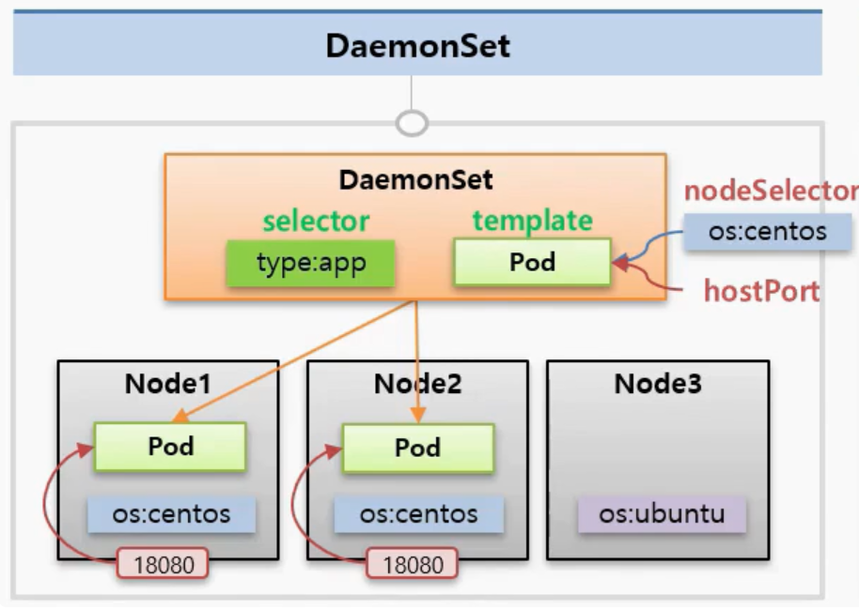
Introduction(2/2)
What is DeamonSet? :
  You should generally not use scheduling restrictions or other parameters to ensure that Pods do not co-locate on the same node. If you find yourself wanting “a single Pod per node”, then a DaemonSet is the correct Kubernetes resource to use. Likewise, if you find yourself building a homogeneous replicated service to serve user traffic, then a ReplicaSet is probably the right Kubernetes resource to use.
  You can use labels to run DaemonSet Pods on specific nodes; for example, you may want to run specialized intrusion-detection software on nodes that are exposed to the edge network.
  You can also use DaemonSets to install software on nodes in a cloud-based cluster. For many cloud services, an upgrade or scaling of a cluster can delete and/or recreate new virtual machines. This dynamic immutable infrastructure approach can cause problems if you want (or are required by central IT) to have specific software on every node. To ensure that specific software is installed on every machine despite upgrades and scale events, a DaemonSet is the right approach. You can even mount the host filesystem and run scripts that install RPM/DEB packages onto the host operating system. In this way, you can have a cloud-native cluster that still meets the enterprise requirements of your IT department.

Slide 5
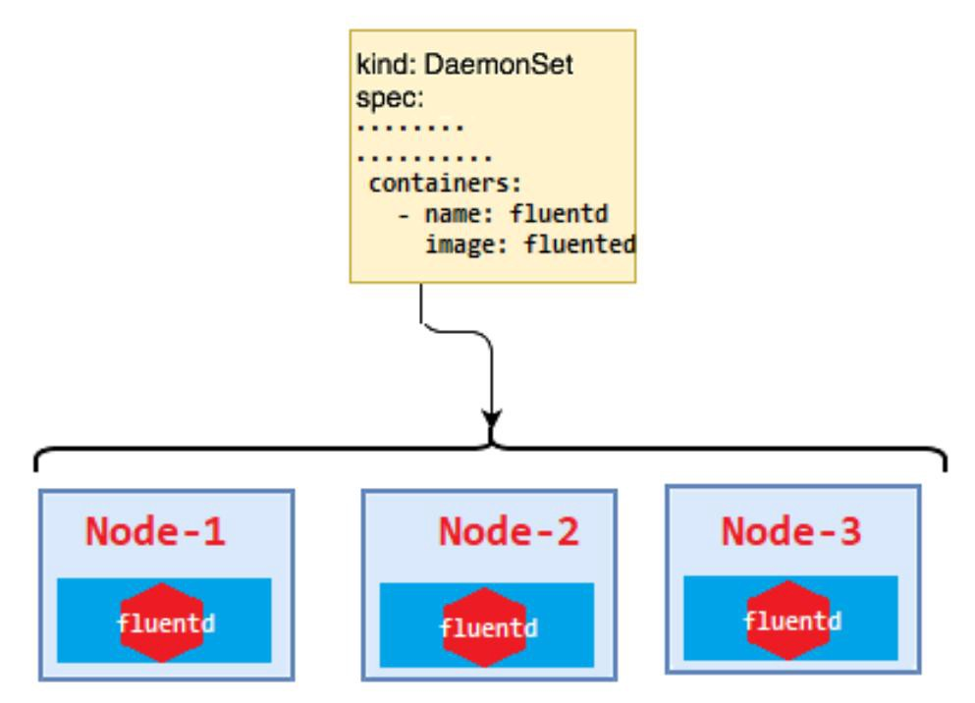
DaemonSet Scheduler(1/2)
DaemonSet Controller :
  By default a DaemonSet will create a copy of a Pod on every node unless a “node selector” is used, which will limit eligible nodes to those with a matching set of labels. DaemonSets determine which node a Pod will run on at Pod creation time by specifying the “nodeName” field in the Pod spec. As a result, Pods created by DaemonSets are ignored by the Kubernetes scheduler.
  Like ReplicaSets, DaemonSets are managed by a “reconciliation control loop” that measures the desired state (a Pod is present on all nodes) with the observed state (is the Pod present on a particular node?). Given this information, the “DaemonSet controller” creates a Pod on each node that doesn’t currently have a matching Pod. If a new node is added to the cluster, then the DaemonSet controller notices that it is missing a Pod and adds the Pod to the new node.

Slide 6
DaemonSet Scheduler(2/2)
Decoupling :
  DaemonSets and ReplicaSets are a great demonstration of the value of Kubernetes’s decoupled architecture. It might seem that the right design would be for a ReplicaSet to own the Pods it manages, and for Pods to be subresources of a ReplicaSet. Likewise, the Pods managed by a DaemonSet would be subresources of that DaemonSet. However, this kind of encapsulation would require that tools for dealing with Pods be written two different times, once for DaemonSets and once for ReplicaSets. Instead, Kubernetes uses a decoupled approach where Pods are top-level objects. This means that every tool you have learned for introspecting Pods in the context of ReplicaSets (e.g., “kubectl logs <pod-name>”) is equally applicable to Pods created by DaemonSets.

Slide 7
Creating DaemonSets(1/4)
DaemonSet Configuration :
  DaemonSets are created by submitting a “DaemonSet configuration” to the Kubernetes API server. The following DaemonSet will create a “fluentd logging agent” on every node in the target cluster.
  NOTE : DaemonSets require a “unique name” across all DaemonSets in a given Kubernetes namespace. Each DaemonSet must include a “Pod template spec”, which will be used to create Pods as needed. This is where the similarities between ReplicaSets and DaemonSets end. Unlike ReplicaSets, DaemonSets will create Pods on every node in the cluster by default unless a “node selector” is used.
apiVersion: apps/v1
kind: DaemonSet
metadata:
name: fluentd
# namespace: kube-system
labels:
k8s-app: fluentd-logging
spec:
selector:
matchLabels:
name: fluentd
template:
metadata:
labels:
name: fluentd
spec:
containers:
- name: fluentd
image: fluent/fluentd
resources:
limits:
memory: 200Mi
requests:
cpu: 100m
memory: 200Mi
volumeMounts:
- name: varlog
mountPath: /var/log
- name: varlibdockercontainers
mountPath: /var/lib/docker/containers
readOnly: true
terminationGracePeriodSeconds: 30
volumes:
- name: varlog
hostPath:
path: /var/log
- name: varlibdockercontainers
hostPath:
path: /var/lib/docker/containers
fluentd-daemonset.yaml

Slide 8
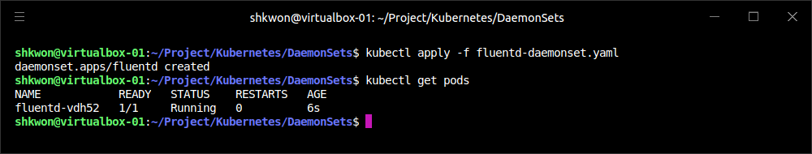
Creating DaemonSets(2/4)
DaemonSet Configuration :
  Once you have a valid DaemonSet configuration in place, you can use the “kubectl apply” command to submit the DaemonSet to the Kubernetes API. Here we will create a DaemonSet to ensure the “fluentd HTTP server” is running on every node in our cluster :
$ kubectl apply -f fluentd-daemonset.yaml

Slide 9
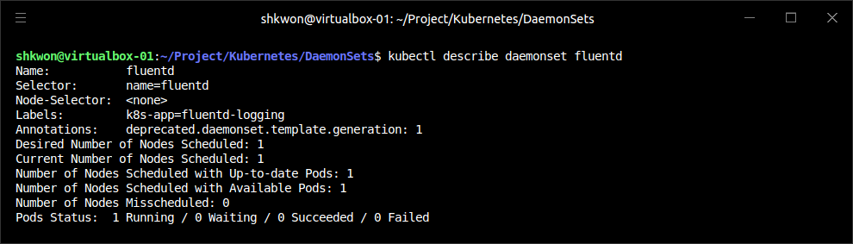
Creating DaemonSets(3/4)
DaemonSet Configuration :
  Once the “fluentd” DaemonSet has been successfully submitted to the Kubernetes API, you can query its current state using the “kubectl describe” command :
  NOTE : This output indicates a “fluentd” Pod was successfully deployed to all nodes in our cluster(Now we have only one node.).
$ kubectl describe daemonset fluentd

Slide 10
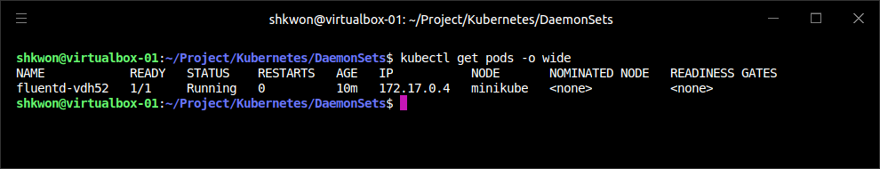
Creating DaemonSets(4/4)
DaemonSet Configuration :
  We can verify this using the “kubectl get pods” command with the “-o” flag to print the nodes where each “fluentd” Pod was assigned :
  With the “fluentd” DaemonSet in place, adding a new node to the cluster will result in a “fluentd” Pod being deployed to that node automatically. This is exactly the behavior you want when managing logging daemons and other cluster-wide services. No action was required from our end; this is how the Kubernetes DaemonSet controller reconciles its observed state with our desired state.
$ kubectl get pods -o wide

Slide 11
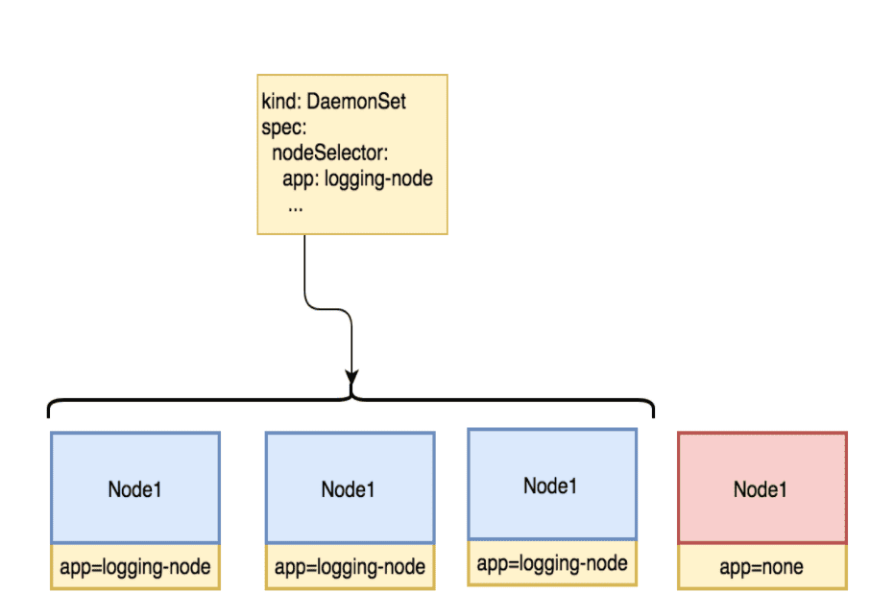
Limiting DaemonSets to Specific Nodes(1/4)
Node Label :
  The most common use case for DaemonSets is to run a Pod across every node in a Kubernetes cluster. However, there are some cases where you want to deploy a Pod to only a subset of nodes. For example, maybe you have a workload that requires a GPU or access to fast storage only available on a subset of nodes in your cluster. In cases like these, “node labels” can be used to tag specific nodes that meet workload requirements.

Slide 12
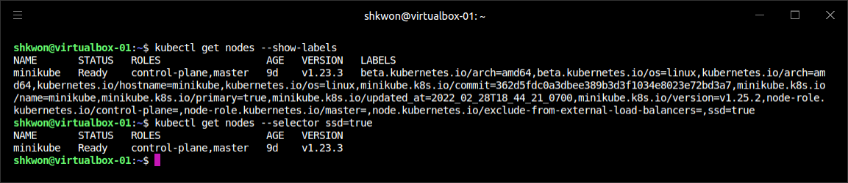
Limiting DaemonSets to Specific Nodes(2/4)
Adding Labels to Nodes :
  The first step in limiting DaemonSets to specific nodes is to add the desired set of labels to a subset of nodes. This can be achieved using the “kubectl label” command.
  The following command adds the “ssd=true” label to a single node :
  Just like with other Kubernetes resources, listing nodes without a label selector returns all nodes in the cluster :
  Using a label selector, we can filter nodes based on labels. To list only the nodes that have the “ssd” label set to true, use the “kubectl get nodes” command with the “--selector” flag :
$ kubectl label nodes <NODE_NAME> ssd=true
$ kubectl get nodes
$ kubectl get nodes --selector ssd=true

Slide 13
Limiting DaemonSets to Specific Nodes(3/4)
Node Selectors :
  “Node selectors” can be used to limit what nodes a Pod can run on in a given Kubernetes cluster. “Node selectors” are defined as part of the “Pod spec” when creating a DaemonSet. The following “DaemonSet configuration” limits “NGINX” to running only on nodes with the “ssd=true” label set.
apiVersion: apps/v1
kind: DaemonSet
metadata:
labels:
app: nginx
ssd: "true"
name: nginx-ssd
spec:
selector:
matchLabels:
name: nginx
template:
metadata:
labels:
name: nginx
spec:
nodeSelector:
ssd: "true"
containers:
- name: nginx
image: nginx
nginx-ssd-daemonset.yaml

Slide 14
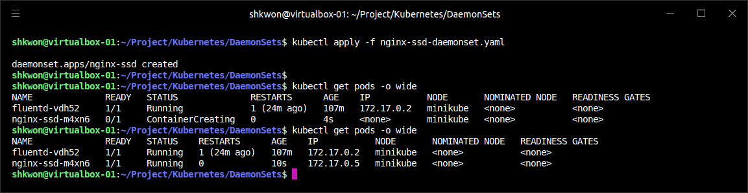
Limiting DaemonSets to Specific Nodes(4/4)
Node Selectors :
  Let’s submit the “nginx-ssd” DaemonSet to the Kubernetes API :
  Since there is only one node(“minikube”) with the “ssd=true” label, the “nginx-ssd” Pod will only run on that node :
  NOTICE!!! : Removing labels from a node that are required by a DaemonSet’s node selector will cause the Pod being managed by that DaemonSet to be removed from the node.
$ kubectl apply -f nginx-ssd-daemonset.yaml
$ kubectl get pods -o wide

Slide 15
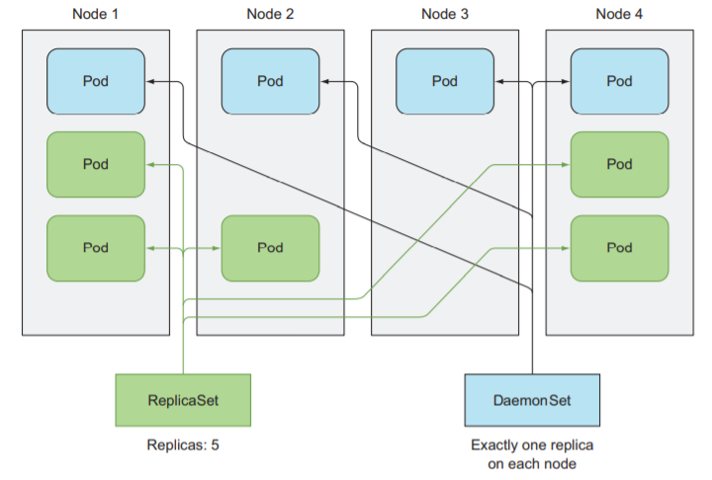
Updating a DaemonSet(1/2)
Rolling Update of a DaemonSet :
  DaemonSets are great for deploying services across an entire cluster, but what about upgrades? Prior to Kubernetes 1.6, the only way to update Pods managed by a DaemonSet was to update the DaemonSet and then manually delete each Pod that was managed by the DaemonSet so that it would be re-created with the new configuration. With the release of Kubernetes 1.6, “DaemonSets gained an equivalent to the Deployment object that manages a DaemonSet rollout inside the cluster”.
  DaemonSets can be rolled out using the same “RollingUpdate“ strategy that deployments use. You can configure the update strategy using the “spec.updateStrategy.type” field, which should have the value “RollingUpdate”. When a DaemonSet has an update strategy of RollingUpdate, any change to the “spec.template” field (or subfields) in the DaemonSet will initiate a rolling update(Refer to “kubectl apply -f command”).

Slide 16
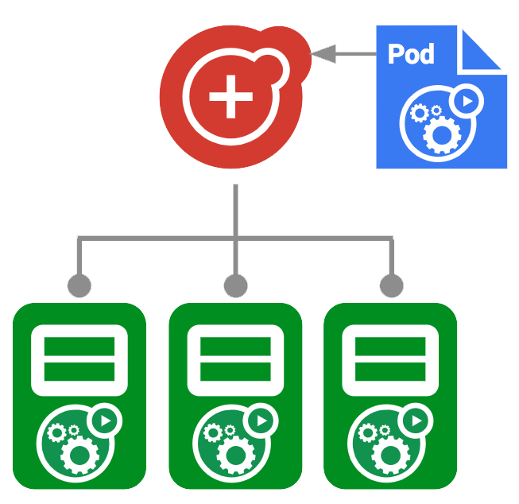
Updating a DaemonSet(2/2)
Rolling Update of a DaemonSet :
  As with rolling updates of deployments, the RollingUpdate strategy “gradually updates” members of a DaemonSet until all of the Pods are running the new configuration. There are two parameters that control the rolling update of a DaemonSet:
    “spec.minReadySeconds”, which determines how long a Pod must be “ready” before the rolling update proceeds to upgrade subsequent Pods
    “spec.updateStrategy.rollingUpdate.maxUnavailable”, which indicates how many Pods may be simultaneously updated by the rolling update
  You will likely want to set “spec.minReadySeconds” to a reasonably long value, for example 30–60 seconds, to ensure that your Pod is truly healthy before the rollout proceeds.
  The setting for “spec.updateStrategy.rollingUpdate.maxUnavailable” is more likely to be application-dependent. Setting it to 1 is a safe, general-purpose strategy, but it also takes a while to complete the rollout (number of nodes × minReadySeconds). Increasing the maximum unavailability will make your rollout move faster, but increases the “blast radius” of a failed rollout. The characteristics of your application and cluster environment dictate the relative values of speed versus safety. A good approach might be to set maxUnavailable to 1 and only increase it if users or administrators complain about DaemonSet rollout speed.
  Once a rolling update has started, you can use the “kubectl rollout” commands to see the current status of a DaemonSet rollout.
  For example, “kubectl rollout status daemonSets <YOUR DAEMON SET>” command will show the current rollout status of a DaemonSet.

Slide 17
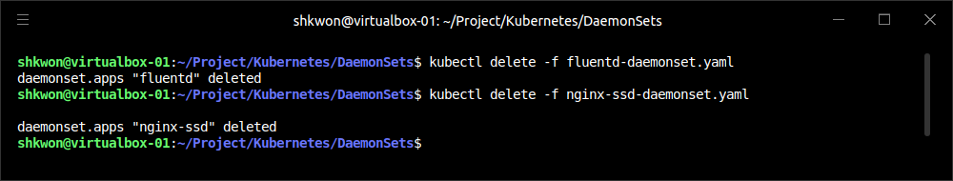
Deleting a DaemonSet
Using DaemonSet Configuration :
  To Delete a DaemonSet, use the “kubectl delete” command. Just be sure to supply the correct name of the DaemonSet you would like to delete :
  NOTE : Deleting a DaemonSet will also delete all the Pods being managed by that DaemonSet. Set the “--cascade” flag to “false” to ensure only the DaemonSet is deleted and not the Pods.
$ kubectl delete -f fluentd-daemonset.yaml
$ kubectl delete -f ngix-ssd-daemonset.yaml

Slide 18
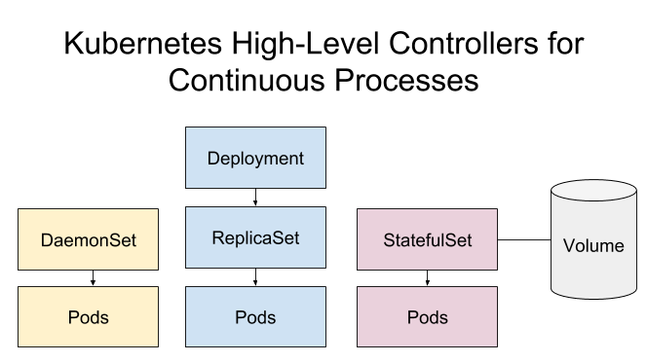
NOTE - Summary
Remember :
  DaemonSets provide an easy-to-use abstraction for running a set of Pods on every node in a Kubernetes cluster, or, if the case requires it, on a subset of nodes based on labels. The DaemonSet provides its own controller and scheduler to ensure key services like monitoring agents are always up and running on the right nodes in your cluster.
  For some applications, you simply want to schedule a certain number of replicas; you don’t really care where they run as long as they have sufficient resources and distribution to operate reliably. However, there is a different class of applications, like agents and monitoring applications, that need to be present on every machine in a cluster to function properly. These DaemonSets aren’t really traditional serving applications, but rather add additional capabilities and features to the Kubernetes cluster itself. Because the DaemonSet is an active declarative object managed by a controller, it makes it easy to declare your intent that an agent run on every machine without explicitly placing it on every machine. This is especially useful in the context of an autoscaled Kubernetes cluster where nodes may constantly be coming and going without user intervention. In such cases, the DaemonSet automatically adds the proper agents to each node as it is added to the cluster by the autoscaler.

Slide 19
Jobs

Slide 20
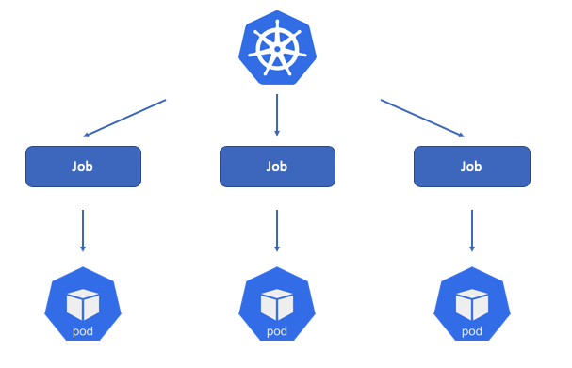
Introduction
What is Job? :
  So far we have focused on long-running processes such as databases and web applications. These types of workloads run until either they are upgraded or the service is no longer needed. While long-running processes make up the large majority of workloads that run on a Kubernetes cluster, there is often a need to run short-lived, one-off tasks. The Job object is made for handling these types of tasks.
  A job creates Pods that run until successful termination (i.e., exit with 0). In contrast, a regular Pod will continually restart regardless of its exit code. Jobs are useful for things you only want to do once, such as database migrations or batch jobs. If run as a regular Pod, your database migration task would run in a loop, continually repopulating the database after every exit.

Slide 21
The Job Object
Job Object and Specification :
  The Job object is responsible for creating and managing Pods defined in a template in the job specification. These Pods generally run until successful completion. The Job object coordinates running a number of Pods in parallel.
  If the Pod fails before a successful termination, the job controller will create a new Pod based on the Pod template in the job specification. Given that Pods have to be scheduled, there is a chance that your job will not execute if the required resources are not found by the scheduler. Also, due to the nature of distributed systems there is a small chance, during certain failure scenarios, that duplicate Pods will be created for a specific task.

Slide 22
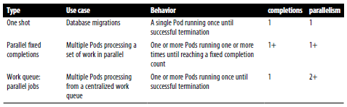
Job Pattern(1/21)
Completions and Parallelism :
  Jobs are designed to manage batch-like workloads where work items are processed by one or more Pods. By default, each job runs a single Pod once until successful termination. This job pattern is defined by two primary attributes of a job, namely the number of job completions and the number of Pods to run in parallel. In the case of the “run once until completion” pattern, the completions and parallelism parameters are set to “1”.

Slide 23
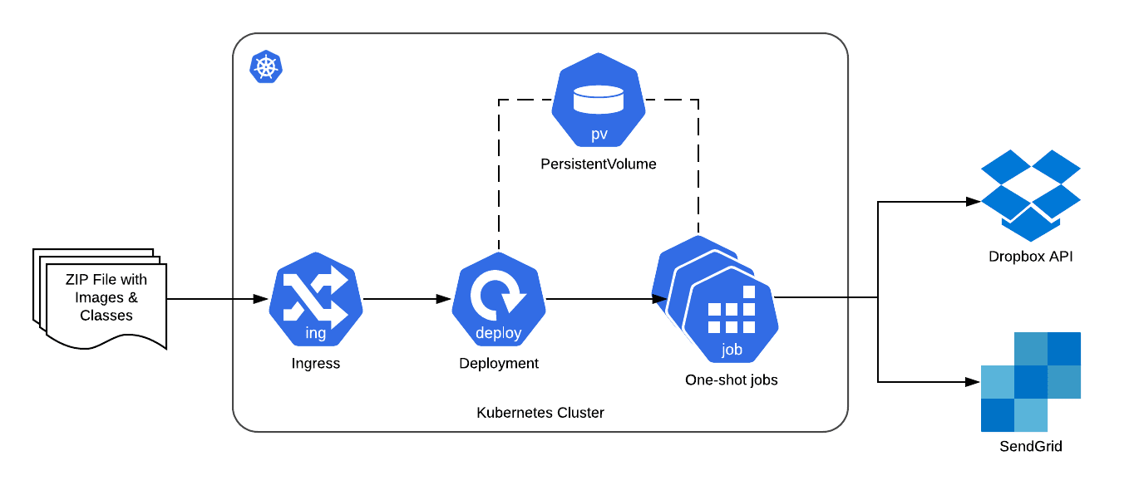
Job Pattern(2/21)
One Shot :
  One-shot jobs provide a way to run a single Pod once until successful termination. While this may sound like an easy task, there is some work involved in pulling this off. First, a Pod must be created and submitted to the Kubernetes API. This is done using a “Pod template” defined in the “job configuration”. Once a job is up and running, the Pod backing the job must be monitored for successful termination. A job can fail for any number of reasons, including an application error, an uncaught exception during runtime, or a node failure before the job has a chance to complete. In all cases, the “job controller” is responsible for recreating the Pod until a successful termination occurs.

Slide 24
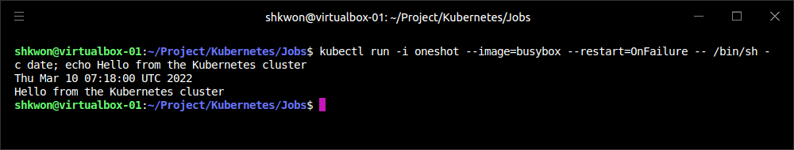
Job Pattern(3/21)
One Shot :
  There are multiple ways to create a one-shot job in Kubernetes. The easiest is to use the “kubectl” command-line tool :
    The “-i(or it)” option to kubectl indicates that this is an interactive command. kubectl will wait until the job is running and then show the log output from the first (and in this case only) Pod in the job.
    “--restart=OnFailure” is the option that tells kubectl to create a Job object.
    All of the options after “--” are command-line arguments to the container image. These instruct “/bin/sh” run with “date” and “echo” shell command.
    kubectl often misses the first couple of lines of output with the “-I” option(Not like in this example).
$ kubectl run -i oneshot --image=busybox --restart=OnFailure -- \
/bin/sh -c date; echo Hello from the Kubernetes cluster

Slide 25
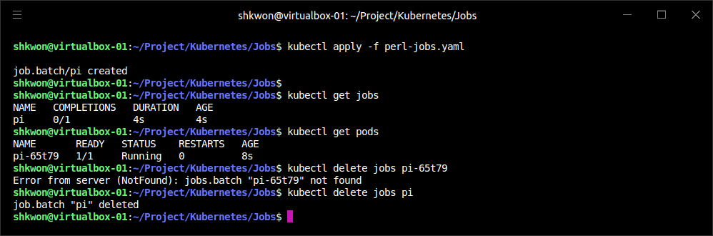
Job Pattern(4/21)
One Shot :
  After the job has completed, the Job object and related Pod are still around. This is so that you can inspect the log output.
  To delete the job, you can use “kubectl delete jobs” command :
apiVersion: batch/v1
kind: Job
metadata:
name: pi
spec:
template:
spec:
containers:
- name: pi
image: perl
command: ["perl", "-Mbignum=bpi", "-wle", "print bpi(2000)"]
restartPolicy: Never
backoffLimit: 4
perl-jobs.yaml

Slide 26
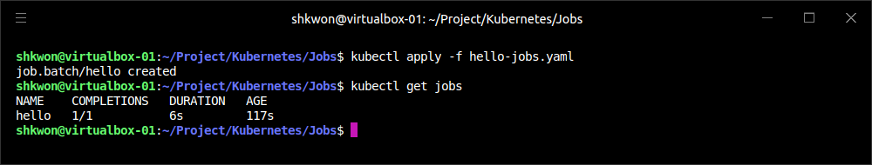
Job Pattern(5/21)
One Shot :
  The other option for creating a one-shot job is using a configuration file, as shown in the following file.
apiVersion: batch/v1
kind: Job
metadata:
name: hello
spec:
template:
spec:
containers:
- name: hello
image: busybox
imagePullPolicy: Always
command:
- /bin/sh
- -c
- date; echo Hello from the Kubernetes cluster
restartPolicy: OnFailure
hello-jobs.yaml

Slide 27
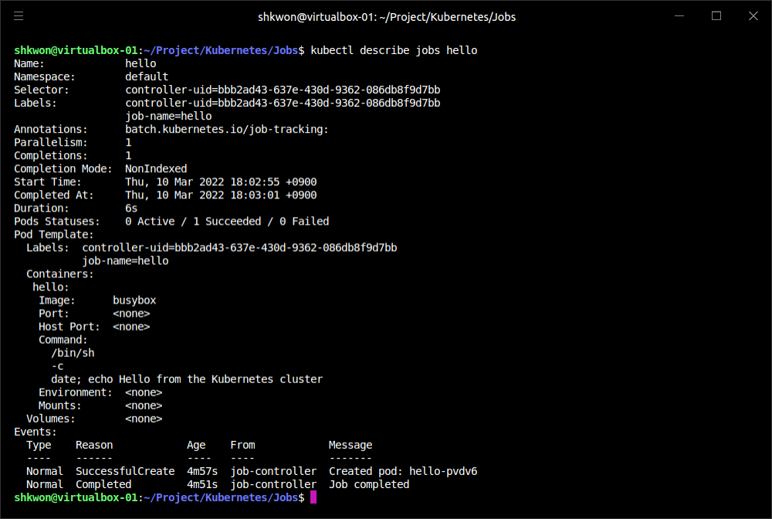
Job Pattern(6/21)
One Shot :
  Then describe the “hello” job -
$ kubectl describe jobs hello

Slide 28
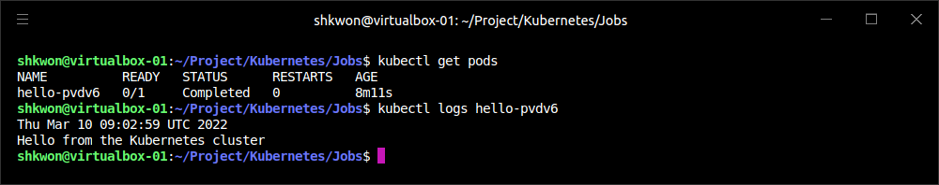
Job Pattern(7/21)
One Shot :
  You can view the results of the job by looking at the logs of the Pod that was created :
  NOTE : You may have noticed that we didn’t specify any labels when creating the Job object. Like with other controllers (DaemonSets, ReplicaSets, deployments, etc.) that use labels to identify a set of Pods, unexpected behaviors can happen if a Pod is reused across objects.
  NOTE : Because jobs have a finite beginning and ending, it is common for users to create many of them. This makes picking unique labels more difficult and more critical. For this reason, the Job object will automatically pick a unique label and use it to identify the Pods it creates. In advanced scenarios (such as swapping out a running job without killing the Pods it is managing), users can choose to turn off this automatic behavior and manually specify labels and selectors.
$ kubectl logs <POD NAME>

Slide 29
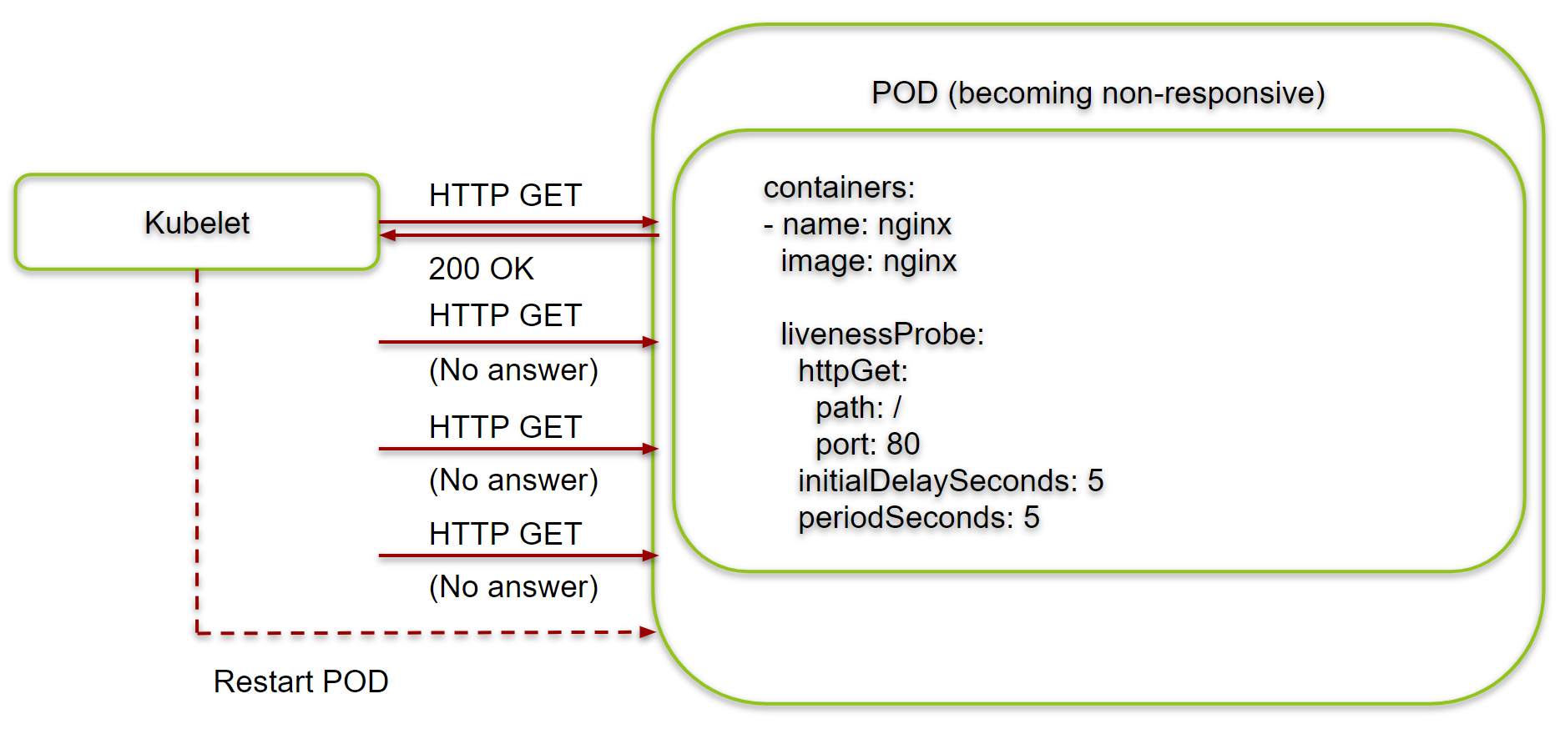
Job Pattern(8/21)
One Shot :
  Pod Failure -
    Kubernetes is in “CrashLoopBackOff” for the failed Pod. It is not uncommon to have a bug someplace that causes a program to crash as soon as it starts. In that case, Kubernetes will wait a bit before restarting the Pod to avoid a crash loop eating resources on the node. This is all handled local to the node by the “kubelet” without the job being involved at all.
    Kill the job (“kubectl delete jobs <JOB NAME>”), and let’s try something else. Modify the config file again and change the “restartPolicy” from “OnFailure” to “Never”.
    By setting “restartPolicy: Never” we are telling the kubelet not to restart the Pod on failure, but rather just declare the Pod as failed. The Job object then notices and creates a replacement Pod. If you aren’t careful, this will create a lot of “junk” in your cluster. For this reason, we suggest you use “restartPolicy: OnFailure” so failed Pods are rerun in place.
    Clean this up with “kubectl delete jobs oneshot”.
    Workers can fail in other ways. Specifically, they can get stuck and not make any forward progress. To help cover this case, you can use “liveness probes” with jobs. If the liveness probe policy determines that a Pod is dead, it’ll be restarted/replaced for you.

Slide 30
Job Pattern(9/21)
Parallelism :
  Let’s start a bunch of workers together to make key generation faster. We’re going to use a combination of the completions and parallelism parameters. Our goal is to generate 100 keys by having 10 runs of “kuard” with each run generating 10 keys. But we don’t want to swamp our cluster, so we’ll limit ourselves to only five Pods at a time.
apiVersion: batch/v1
kind: Job
metadata:
name: parallel
labels:
apps: jobs
spec:
parallelism: 5
completions: 10
template:
metadata:
labels:
apps: jobs
spec:
containers:
- name: kuard
image: gcr.io/kuard-demo/kuard-amd64:1
imagePullPolicy: Always
args:
- "--keygen-enable"
- "--keygen-exit-on-complete"
- "--keygen-num-to-gen=10"
restartPolicy: OnFailure

Slide 31
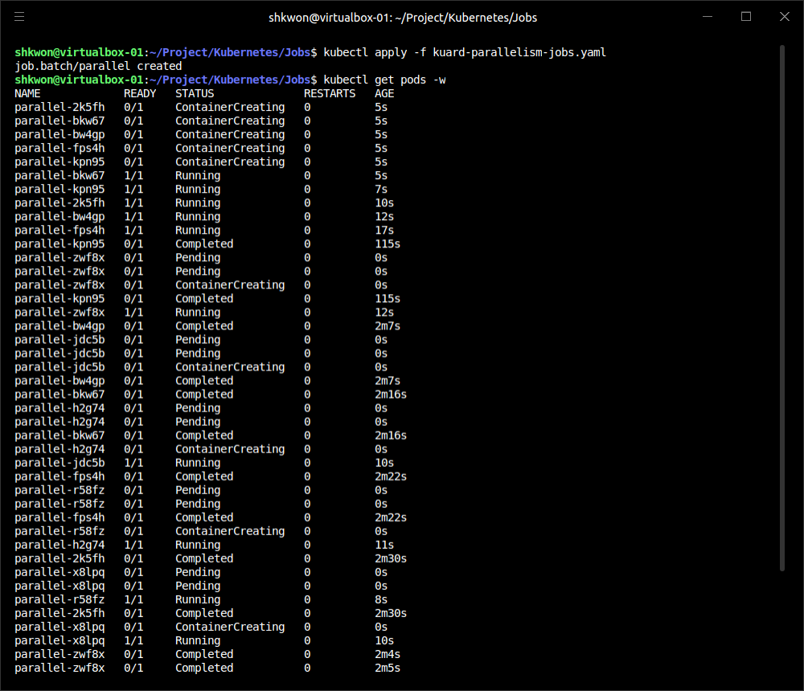
Job Pattern(10/21)
Parallelism :
  Now watch as the Pods come up, do their thing, and exit. New Pods are created until 10 have completed altogether. Here we use the “--watch” flag to have “kubectl” stay around and list changes as they happen :
  Clean up by deleting the finished Job object with “kubectl delete job parallel”.
$ kubectl apply -f kuard-parallelism-jobs.yaml
$ kubectl get pods -w

Slide 32
Job Pattern(11/21)
Work Queues :
  A common use case for jobs is to process work from a “work queue”. In this scenario, some task creates a number of work items and publishes them to a work queue. A worker job can be run to process each work item until the work queue is empty.

Slide 33
Job Pattern(12/21)
Work Queues :
  Starting a work queue -
    We start by launching a “centralized work queue service”. “kuard” has a simple “memory-based work queue system” built in. We will start an instance of “kuard” to act as a coordinator for all the work to be done.
apiVersion: apps/v1
kind: ReplicaSet
metadata:
labels:
app: work-queue
component: queue
chapter: jobs
name: queue
spec:
replicas: 1
selector:
matchLabels:
app: work-queue
component: queue
chapter: jobs
template:
metadata:
labels:
app: work-queue
component: queue
chapter: jobs
spec:
containers:
- name: queue
image: "gcr.io/kuard-demo/kuard-amd64:1“
imagePullPolicy: Always

Slide 34
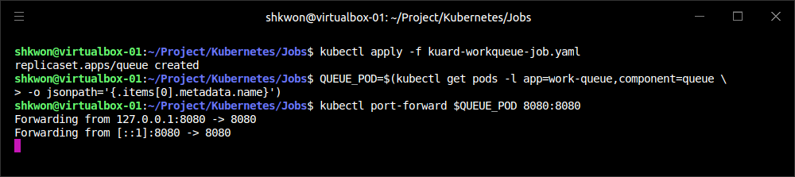
Job Pattern(13/21)
Work Queues :
  Starting a work queue -
    Run the work queue with “kubectl apply -f kuard-workqueue-job.yaml” command. At this point the work queue daemon should be up and running. Let’s use port forwarding to connect to it. Leave this command running in a terminal window :
$ kubectl apply -f kuard-workqueue-job.yaml
$ QUEUE_POD=$(kubectl get pods -l app=work-queue,component=queue \
-o jsonpath='{.items[0].metadata.name}')
$ kubectl port-forward $QUEUE_POD 8080:8080

Slide 35
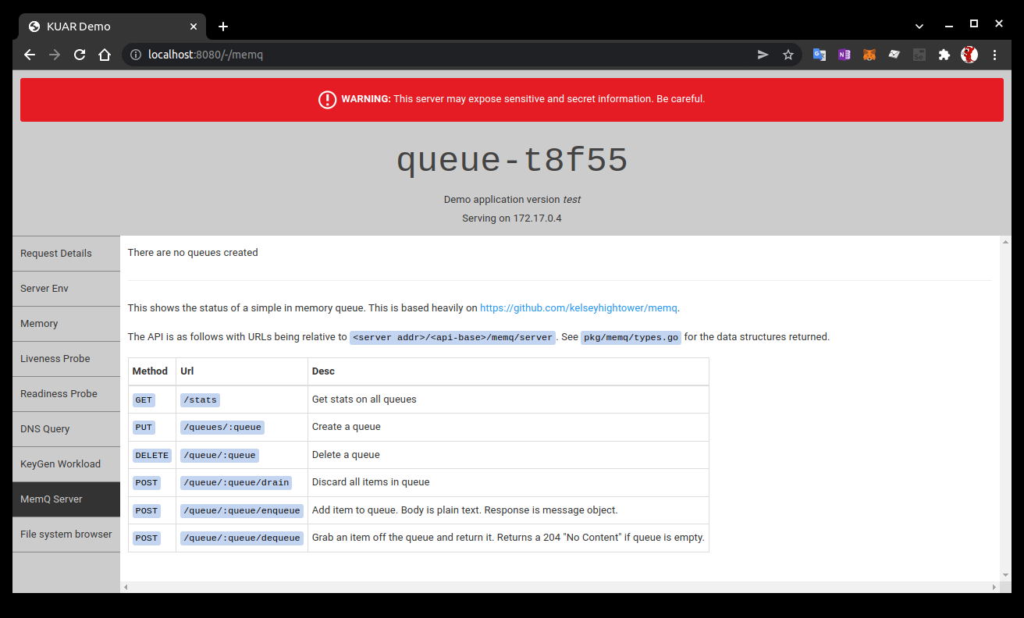
Job Pattern(14/21)
Work Queues :
  Starting a work queue -
    You can open your browser to “http://localhost:8080” and see the “kuard” interface. Switch to the “MemQ Server” tab to keep an eye on what is going on.

Slide 36
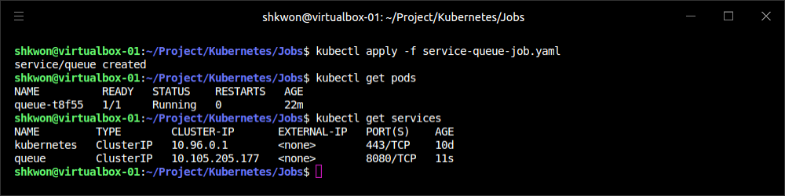
Job Pattern(15/21)
Work Queues :
  Starting a work queue -
    With the work queue server in place, we should “expose it using a service”. This will make it easy for producers and consumers to locate the work queue via DNS.
    Create the queue service with “$kubectl apply -f service-queue-job.yaml” command in the other terminal.
“$ kubectl apply -f service-queue-job.yaml
apiVersion: v1
kind: Service
metadata:
labels:
app: work-queue
component: queue
chapter: jobs
name: queue
spec:
ports:
- port: 8080
protocol: TCP
targetPort: 8080
selector:
app: work-queue
component: queue
service-queue-job.yaml

Slide 37
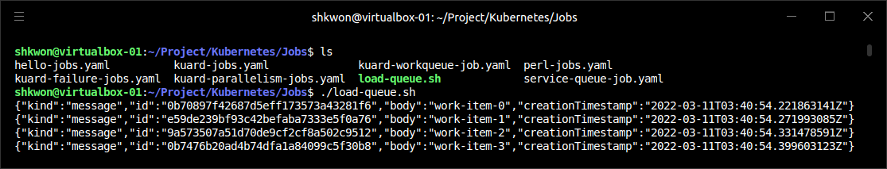
Job Pattern(16/21)
Work Queues :
  Loading up the queue -
    We are now ready to put a bunch of work items in the queue. For the sake of simplicity we’ll just use “curl” to drive the API for the work queue server and insert a bunch of work items. “curl” will communicate to the work queue through the “kubectl port-forward” we set up earlier.
    Run these commands(“chmod +x load-queue.sh; ./load-queue.sh”), and you should see 100 JSON objects output to your terminal with a unique message identifier for each work item.
# Create a work queue called 'keygen'
curl -X PUT localhost:8080/memq/server/queues/keygen
# Create 100 work items and load up the queue.
for i in work-item-{0..99}; do
curl -X POST localhost:8080/memq/server/queues/keygen/enqueue \
-d "$i"
done
load-queue.sh

Slide 38
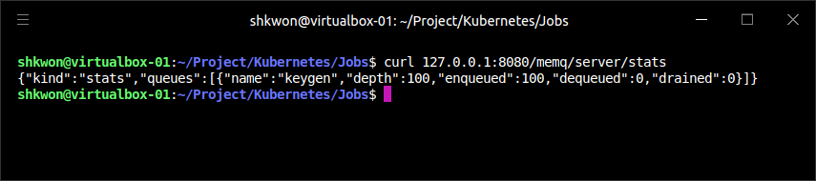
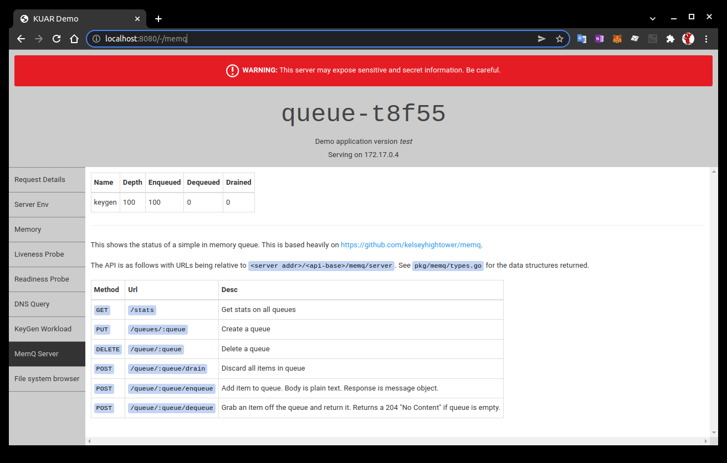
Job Pattern(17/21)
Work Queues :
  Loading up the queue -
    You can confirm the status of the queue by looking at the “MemQ Server” tab in the UI, or you can ask the work queue API directly:
$ curl 127.0.0.1:8080/memq/server/stats
Now we are ready to kick off a job to consume the work queue until it’s empty.

Slide 39
Job Pattern(18/21)
Work Queues :
  Creating the consumer job -
    “kuard” is also able to act in consumer mode. We can set it up to draw work items from the work queue, create a key, and then exit once the queue is empty.
apiVersion: batch/v1
kind: Job
metadata:
labels:
app: message-queue
component: consumer
chapter: jobs
name: consumers
spec:
parallelism: 5
template:
metadata:
labels:
app: message-queue
component: consumer
chapter: jobs
spec:
containers:
- name: worker
image: "gcr.io/kuard-demo/kuard-amd64:1"
imagePullPolicy: Always
args:
- "--keygen-enable"
- "--keygen-exit-on-complete"
- "--keygen-memq-server=http://127.0.0.1:8080/memq/server"
- "--keygen-memq-queue=keygen"
restartPolicy: OnFailure

Slide 40
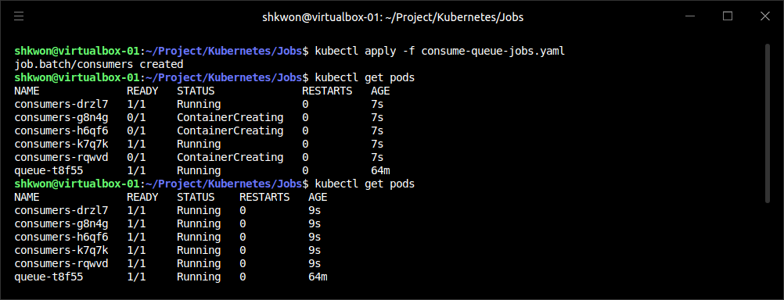
Job Pattern(19/21)
Work Queues :
  Creating the consumer job -
    In YAML file, we are telling the job to start up five Pods in parallel. As the “completions” parameter is unset, we put the job into a worker pool mode. Once the first Pod exits with a zero exit code, the job will start winding down and will not start any new Pods. This means that none of the workers should exit until the work is done and they are all in the process of finishing up.
    Now, create the consumers job. Once the job has been created, you can view the Pods backing the job :
$ kubectl apply -f consume-queue-jobs.yaml
$ kubectl get pods

Slide 41
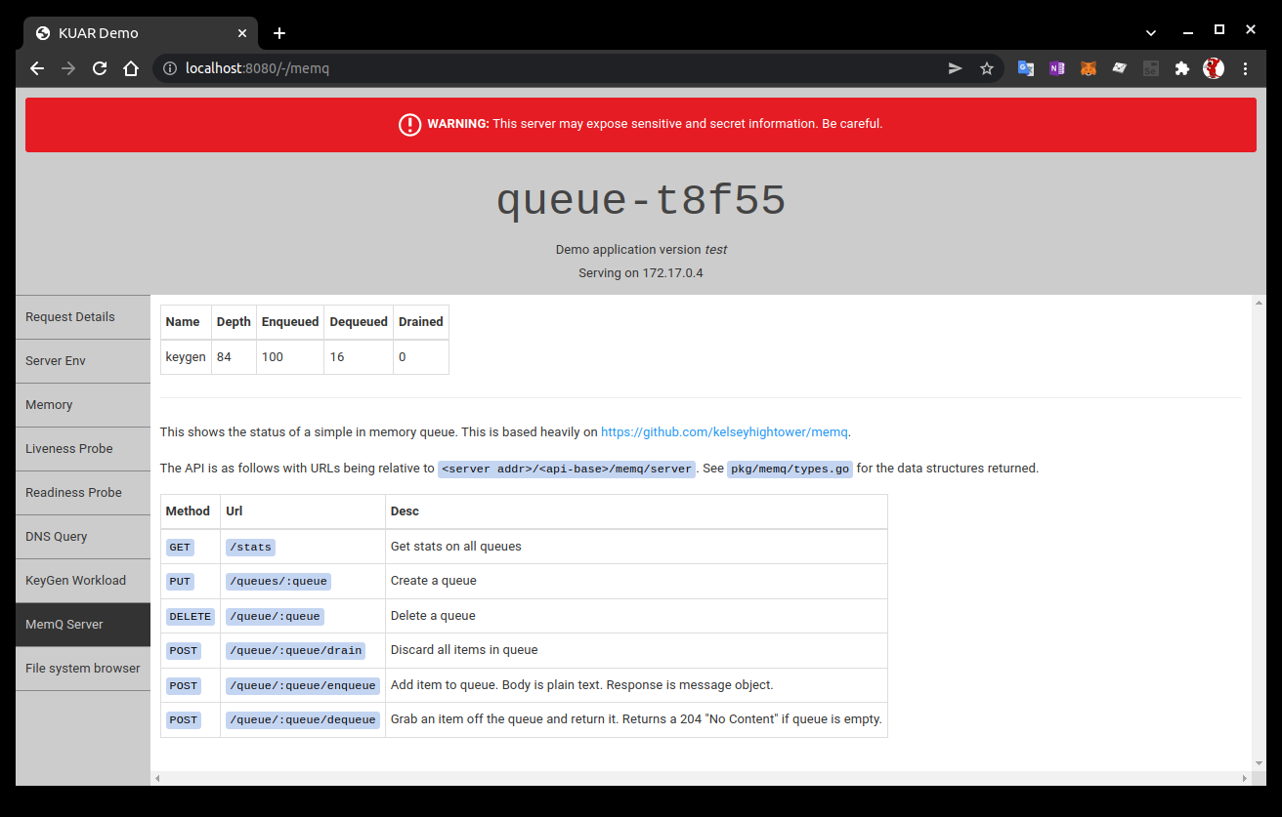
Job Pattern(20/21)
Work Queues :
  Creating the consumer job -
    Note there are five Pods running in parallel. These Pods will continue to run until the work queue is empty. You can watch as it happens in the UI on the work queue server. As the queue empties, the consumer Pods will exit cleanly and the consumers job will be considered complete.

Slide 42
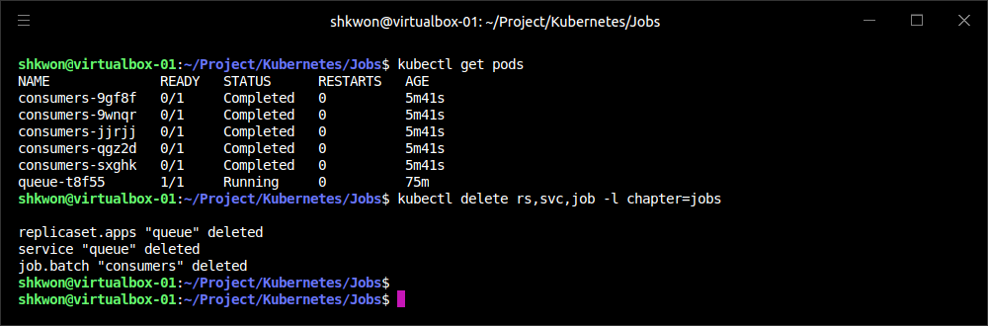
Job Pattern(21/21)
Work Queues :
  Clean up -
    Using labels, we can clean up all of the stuff we created :
    NOTE : “rs” means “replicaset”. “svc” means “service”. “job” means “job”. “-l” means “label”.
$ kubectl delete rs,svc,job -l chapter=jobs

Slide 43
CronJobs(1/2)
Interval Job :
  Sometimes you want to schedule a job to be run at a certain “interval”. To achieve this you can declare a “CronJob” in Kubernetes, which is responsible for creating a new Job object at a particular interval. The declaration of a CronJob looks like :
  Note : The “spec.schedule” field, which contains the interval for the CronJob in standard “cron” format.
apiVersion: batch/v1
kind: CronJob
metadata:
name: hello
spec:
# Run every fifth hour
schedule: "0 */5 * * *"
jobTemplate:
spec:
template:
spec:
containers:
- name: hello
image: busybox
imagePullPolicy: Always
command:
- /bin/sh
- -c
- date; echo Hello from the Kubernetes cluster
restartPolicy: OnFailure
cron-jobs.yaml

Slide 44
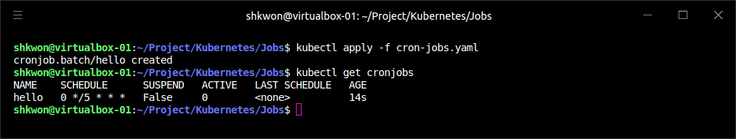
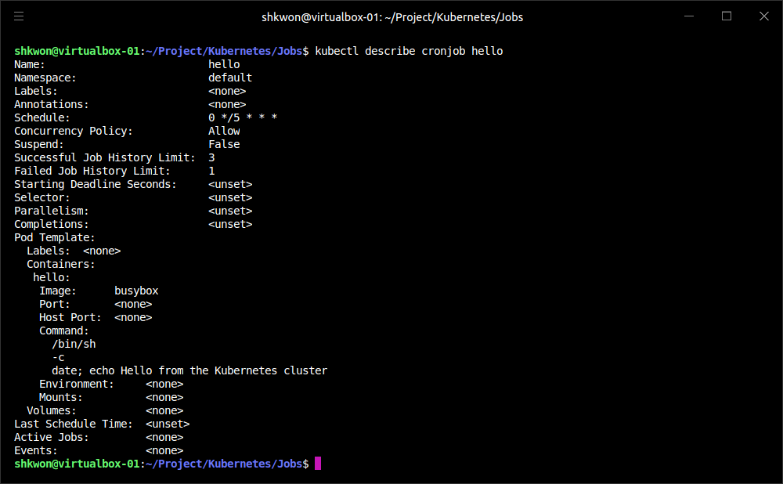
CronJobs(2/2)
Interval Job :
  You can save this file as “cron-jobs.yaml”, and create the CronJob with “kubectl create -f cron-jobs.yaml” command. If you are interested in the current state of a CronJob, you can use “kubectl describe cronjob <cron-job>” to get the details.
$ kubectl create -f cron-jobs.yaml
$ kubectl get cronjobs
$ kubectl describe cronjob hello

Slide 45
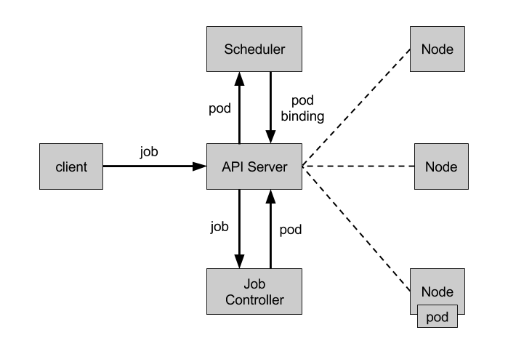
NOTE : Summary
Remember :
  On a single cluster, Kubernetes can handle both long-running workloads such as web applications and short-lived workloads such as batch jobs. The job abstraction allows you to model batch job patterns ranging from simple one-time tasks to parallel jobs that process many items until work has been exhausted.
  Jobs are a low-level primitive and can be used directly for simple workloads. However, Kubernetes is built from the ground up to be extensible by higher-level objects. Jobs are no exception; they can easily be used by higher-level orchestration systems to take on more complex tasks.

Slide 46
ConfigMaps and Secrets

Slide 47
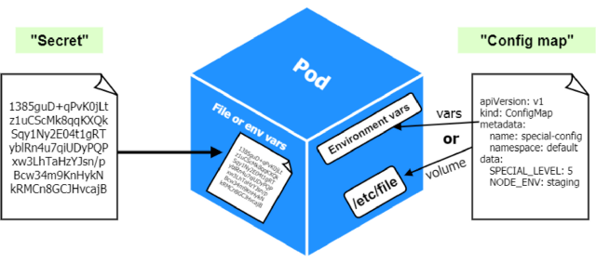
Introduction
What is ConfigMaps and Secrets ? :
  It is a good practice to make container images as reusable as possible. The same image should be able to be used for development, staging, and production. It is even better if the same image is general-purpose enough to be used across applications and services. Testing and versioning get riskier and more complicated if images need to be recreated for each new environment. But then how do we specialize the use of that image at runtime?
  This is where ConfigMaps and secrets come into play. ConfigMaps are used to provide configuration information for workloads. This can either be fine-grained information (a short string) or a composite value in the form of a file. Secrets are similar to ConfigMaps but focused on making sensitive information available to the workload. They can be used for things like credentials or TLS certificates.

Slide 48
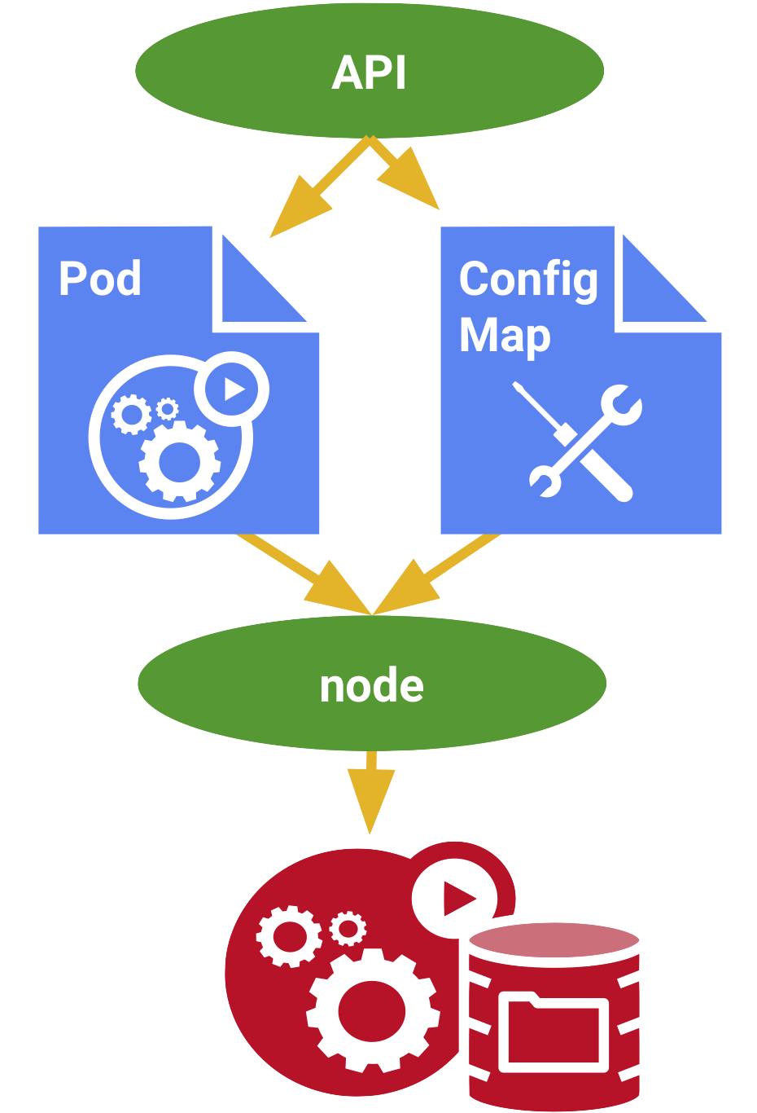
ConfigMaps(1/9)
Combining :
  One way to think of a ConfigMap is as a Kubernetes object that defines a “small filesystem”. Another way is as “a set of variables” that can be used when defining the environment or command line for your containers. The key thing is that the ConfigMap is combined with the Pod right before it is run. This means that the container image and the Pod definition itself can be reused across many apps by just changing the ConfigMap that is used.

Slide 49
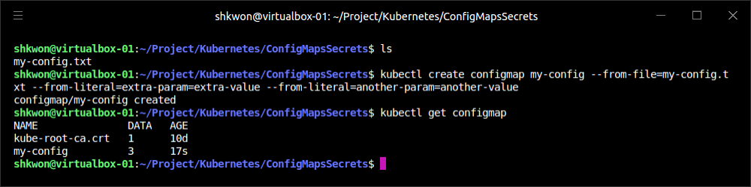
ConfigMaps(2/9)
Creating ConfigMaps :
  Like many objects in Kubernetes, you can create these in an immediate, imperative way, or you can create them from a manifest on disk. We’ll start with the imperative method. First, suppose we have a file on disk (called “my-config.txt”) that we want to make available to the Pod in question.
  Next, let’s create a ConfigMap with that file. We’ll also add a couple of simple key/value pairs here. These are referred to as literal values on the command line :
# This is a sample config file that I might use to configure an application
parameter1 = value1
parameter2 = value2
$ kubectl create configmap my-config \
--from-file=my-config.txt \
--from-literal=extra-param=extra-value \
--from-literal=another-param=another-value

Slide 50
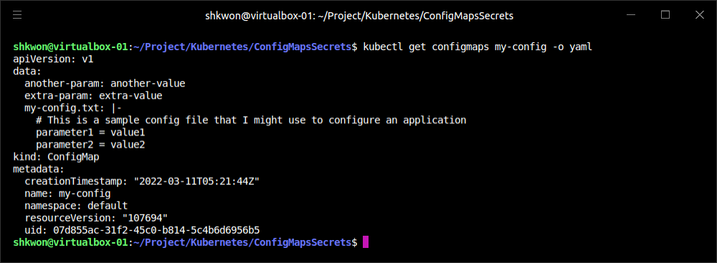
ConfigMaps(3/9)
Creating ConfigMaps :
  The equivalent YAML for the ConfigMap object we just created is :
  The ConfigMap is really just some “key/value pairs” stored in an object.
$ kubectl get configmaps my-config -o yaml

Slide 51
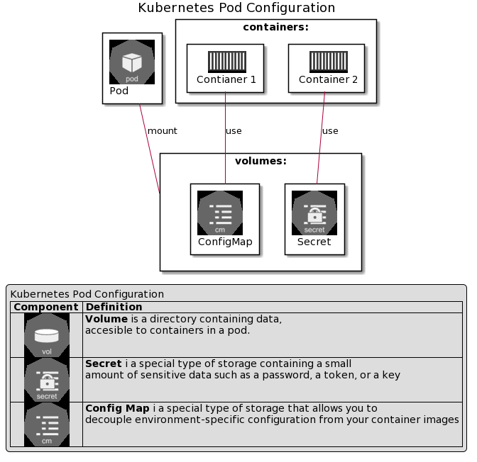
ConfigMaps(4/9)
Using a ConfigMap :
  There are three main ways to use a ConfigMap :
    Filesystem - You can mount a ConfigMap into a Pod. A file is created for each entry based on the key name. The contents of that file are set to the value.
    Environment variable - A ConfigMap can be used to dynamically set the value of an environment variable.
    Command-line argument - Kubernetes supports dynamically creating the command line for a container based on ConfigMap values.

Slide 52
ConfigMaps(5/9)
Using a ConfigMap :
  Let’s create a manifest for “kuard” that pulls all of these together.
apiVersion: v1
kind: Pod
metadata:
name: kuard-config
spec:
containers:
- name: test-container
image: gcr.io/kuar-demo/kuard-amd64:1
imagePullPolicy: Always
command:
- "/kuard"
- "$(EXTRA_PARAM)"
env:
- name: ANOTHER_PARAM
valueFrom:
configMapKeyRef:
name: my-config
key: another-param
- name: EXTRA_PARAM
valueFrom:
configMapKeyRef:
name: my-config
key: extra-param
volumeMounts:
- name: config-volume
mountPath: /config
volumes:
- name: config-volume
configMap:
name: my-config
restartPolicy: Never
kuard-config.yaml

Slide 53
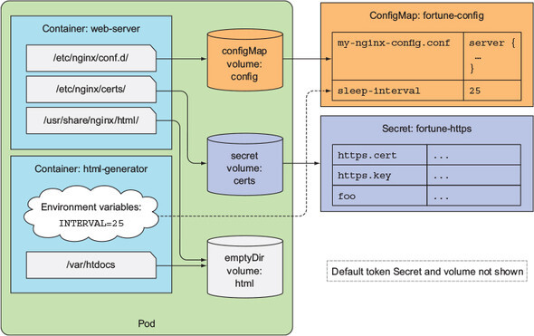
ConfigMaps(6/9)
Using a ConfigMap :
  For the filesystem method, we create a new volume inside the Pod and give it the name “config-volume”. We then define this volume to be a “ConfigMap volume” and point at the ConfigMap to mount. We have to specify where this gets mounted into the “kuard” container with a “volumeMount”. In this case we are mounting it at “/config”.
  Environment variables are specified with a special “valueFrom” member. This references the ConfigMap and the data key to use within that ConfigMap.
  Command-line arguments build on environment variables. Kubernetes will perform the correct substitution with a special $(<env-var-name>) syntax.

Slide 54
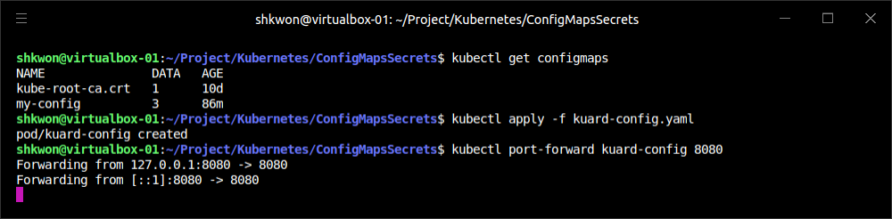
ConfigMaps(7/9)
Using a ConfigMap :
  Run the previous Pod, and let’s port forward to examine how the app sees the world :
$ kubectl apply -f kuard-config.yaml
$ kubectl port-forward kuard-config 8080

Slide 55
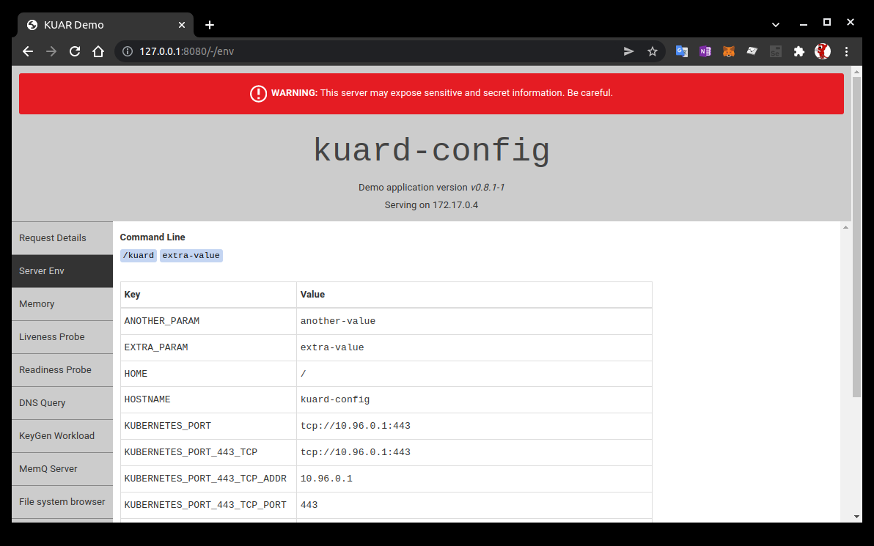
ConfigMaps(8/9)
Using a ConfigMap :
  Now point your browser at “http://127.0.0.1:8080“ in Chrome browser. We can look at how we’ve injected configuration values into the program in all three ways. Click the “Server Env” tab on the left. This will show the command line that the app was launched with along with its environment.

Slide 56
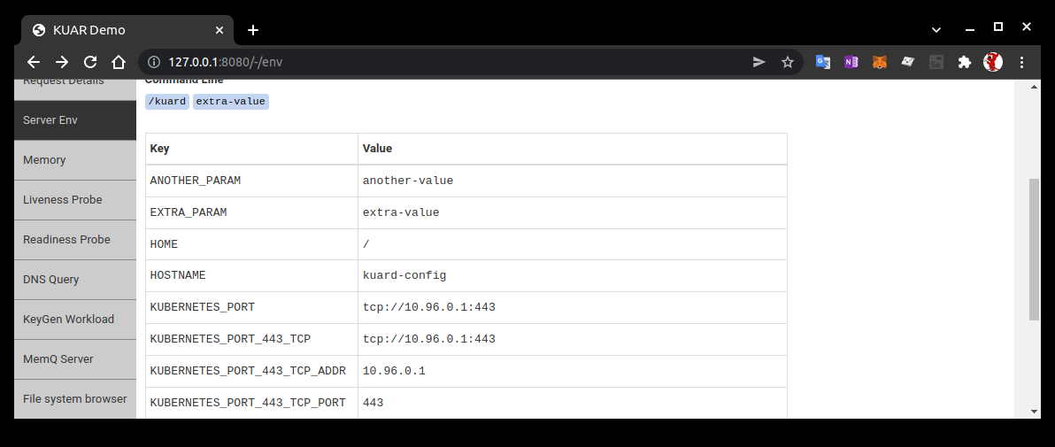
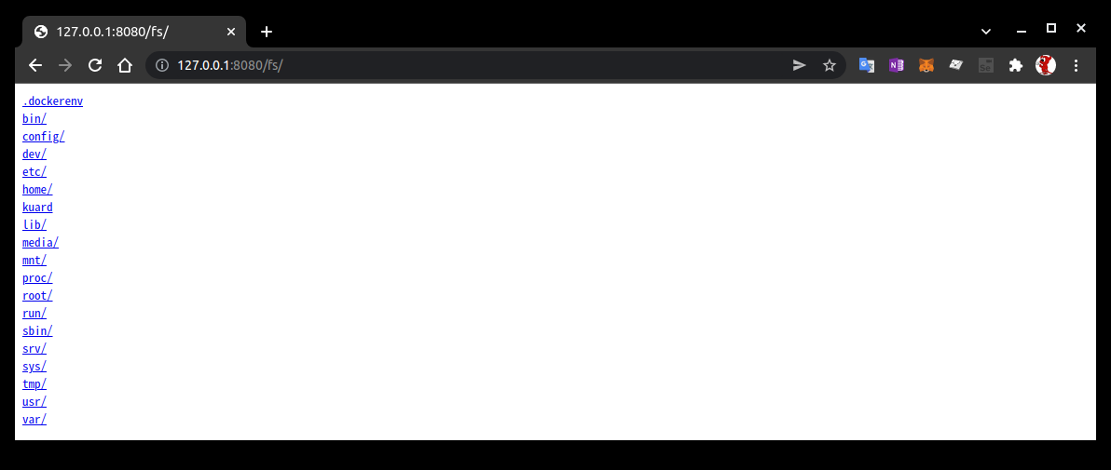
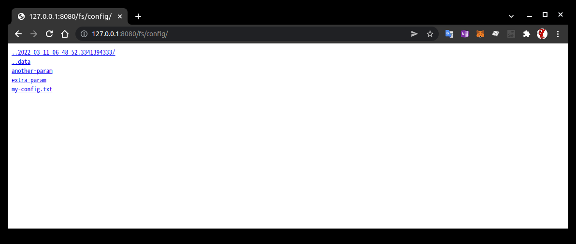
ConfigMaps(9/9)
Using a ConfigMap :
  Here we can see that we’ve added two environment variables (ANOTHER_PARAM and EXTRA_PARAM) whose values are set via the ConfigMap. Furthermore, we’ve added an argument to the command line of “kuard” based on the EXTRA_PARAM value.
  Next, click the “File system browser” tab. This lets you explore the filesystem as the application sees it. You should see an entry called “/config”. This is a volume created based on our ConfigMap. If you navigate into that, you’ll see that a file has been created for each entry of the ConfigMap. You’ll also see some “hidden files (prepended with ..)” that are used to do a clean swap of new values when the ConfigMap is updated.

Slide 57
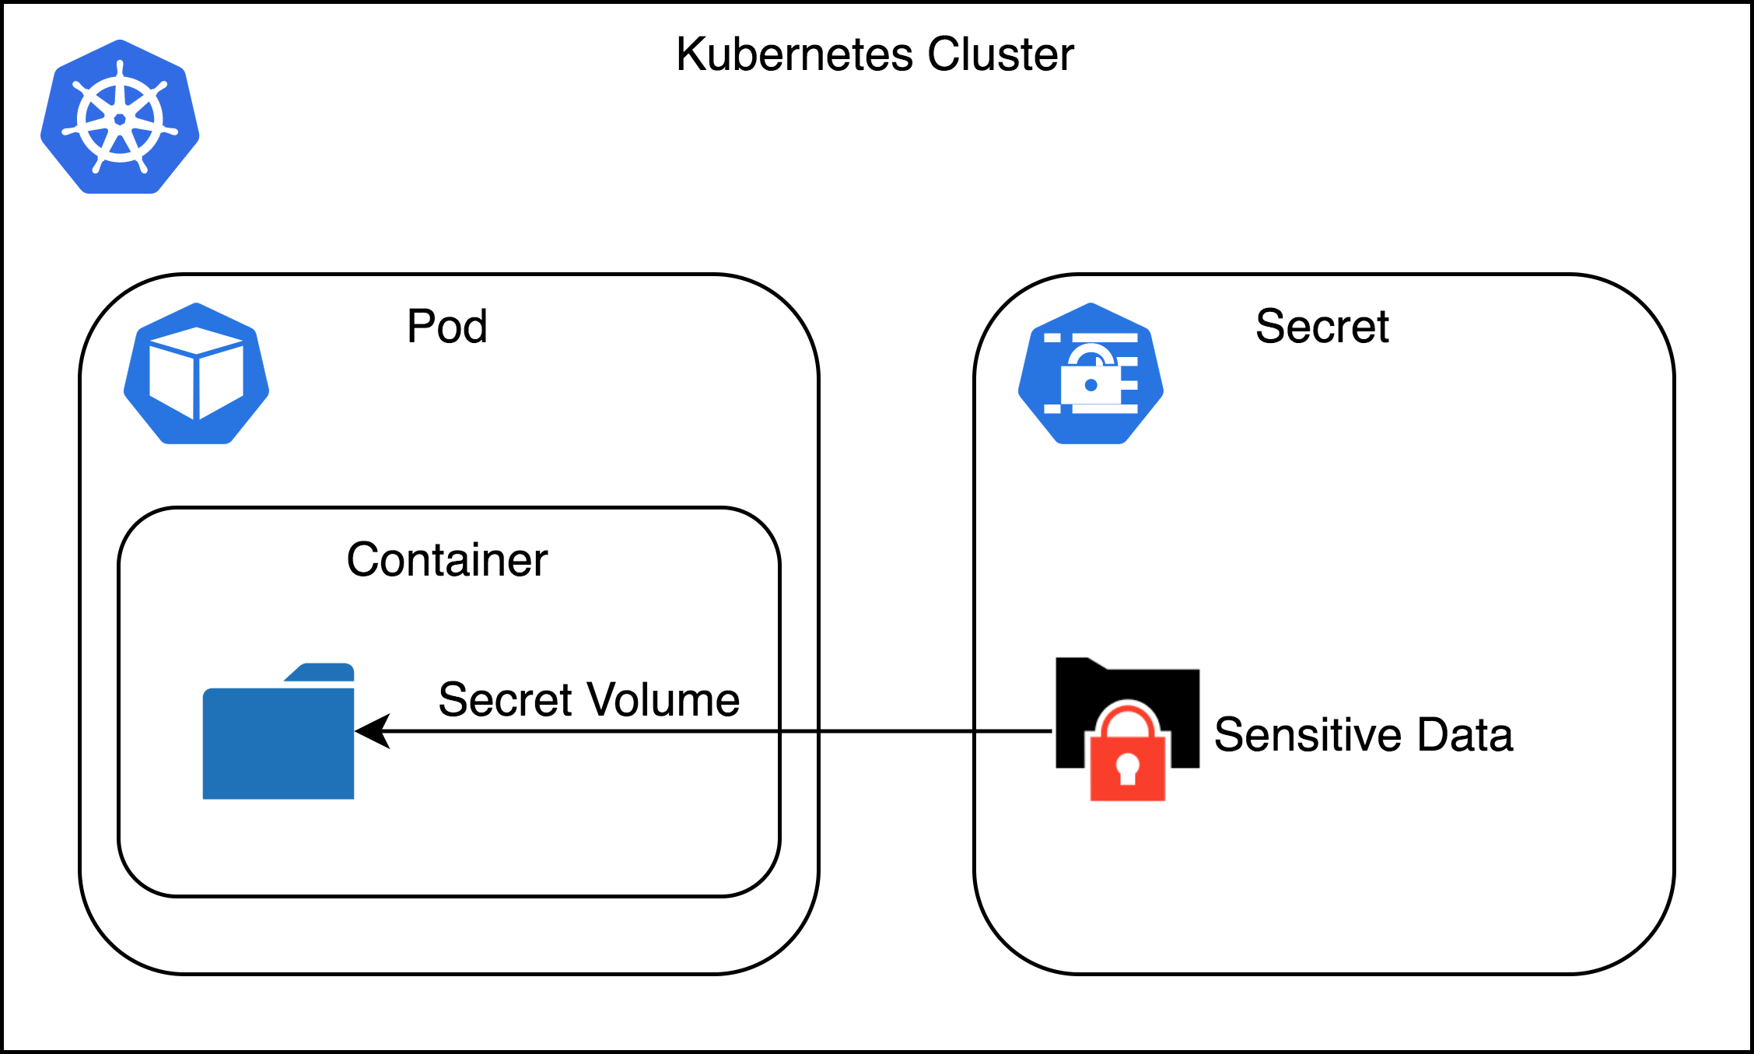
Secrets(1/9)
What is Secrets? :
  While ConfigMaps are great for most configuration data, there is certain data that is extra-sensitive. This can include passwords, security tokens, or other types of private keys. Collectively, we call this type of data “secrets.” Kubernetes has native support for storing and handling this data with care.
  Secrets enable container images to be created without bundling sensitive data. This allows containers to remain portable across environments. Secrets are exposed to Pods via explicit declaration in Pod manifests and the Kubernetes API. In this way, the Kubernetes secrets API provides an application-centric mechanism for exposing sensitive configuration information to applications in a way that’s easy to audit and leverages native OS isolation primitives.
  NOTE : By default, Kubernetes secrets are stored in plain text in the “etcd”(Etc Distributed : Replicated State Machine) storage for the cluster. Depending on your requirements, this may not be sufficient security for you. In particular, anyone who has cluster administration rights in your cluster will be able to read all of the secrets in the cluster. In recent versions of Kubernetes, support has been added for encrypting the secrets with a user-supplied key, generally integrated into a cloud key store. Additionally, most cloud key stores have integration with Kubernetes flexible volumes, enabling you to skip Kubernetes secrets entirely and rely exclusively on the cloud provider’s key store. All of these options should provide you with sufficient tools to craft a security profile that suits your needs.

Slide 58
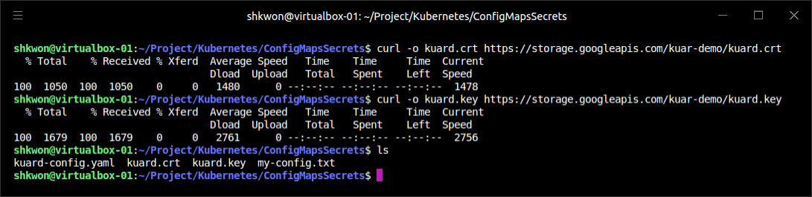
Secrets(2/9)
Creating Secrets :
  Secrets are created using the Kubernetes API or the kubectl command-line tool. Secrets hold one or more data elements as “a collection of key/value pairs”. Here we will create a secret to store a TLS key and certificate for the “kuard” application that meets the storage requirements listed previously.
  The “kuard” container image does not bundle a TLS certificate or key. This allows the “kuard” container to remain portable across environments and distributable through public Docker repositories.
  The first step in creating a secret is to obtain the raw data we want to store. The TLS key and certificate for the “kuard” application can be downloaded by running the following commands :
$ curl -o kuard.crt https://storage.googleapis.com/kuar-demo/kuard.crt
$ curl -o kuard.key https://storage.googleapis.com/kuar-demo/kuard.key

Slide 59
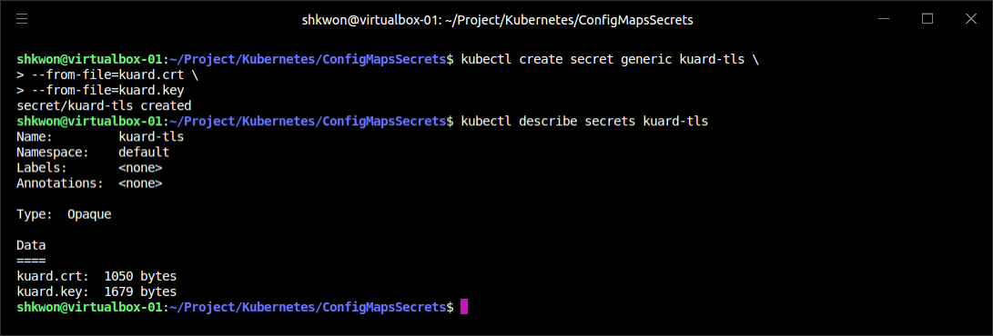
Secrets(3/9)
Creating Secrets :
  With the kuard.crt and kuard.key files stored locally, we are ready to create a secret. Create a secret named kuard-tls using the create secret command :
  The “kuard-tls” secret has been created with two data elements. Run the following command to get details :
$ kubectl create secret generic kuard-tls \
--from-file=kuard.crt \
--from-file=kuard.key
$ kubectl describe secrets kuard-tls

Slide 60
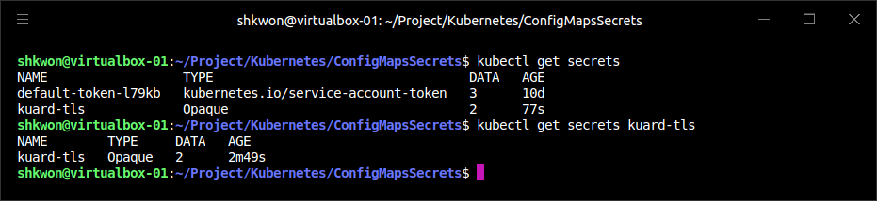
NOTE : Secrets in Kubernetes
Getting Secrets :
  You can use “kubectl get secrets” command to see the secrets in the Kubernetes.
$ kubectl get secrets
$ kubectl get secrets <SECRET NAME>

Slide 61

Secrets(4/9)
Consuming Secrets :
  Secrets can be consumed using the Kubernetes REST API by applications that know how to call that API directly. However, our goal is to keep applications portable. Not only should they run well in Kubernetes, but they should run, unmodified, on other platforms. Instead of accessing secrets through the API server, we can use a secrets volume.
  Secret volumes -
    Secret data can be exposed to Pods using the “secrets volume type”. Secrets volumes are managed by the kubelet and are created at Pod creation time. Secrets are stored on “tmpfs(Temporary File System)” volumes (aka RAM disks), and as such are not written to disk on nodes. Each data element of a secret is stored in a separate file under “the target mount point specified in the volume mount”.
    The “kuard-tls” secret contains two data elements : “kuard.crt” and “kuard.key”. Mounting the “kuard-tls” secrets volume to “/tls” results in the following files :
/tls/kuard.crt
/tls/kuard.key

Slide 62
Secrets(5/9)
Consuming Secrets :
  Secret volumes -
    The following Pod manifest demonstrates how to declare a secrets volume, which exposes the “kuard-tls” secret to the “kuard” container under “/tls”.
apiVersion: v1
kind: Pod
metadata:
name: kuard-tls
spec:
containers:
- name: kuard-tls
image: gcr.io/kuar-demo/kuard-amd64:1
imagePullPolicy: Always
volumeMounts:
- name: tls-certs
mountPath: "/tls"
readOnly: true
volumes:
- name: tls-certs
secret:
secretName: kuard-tls
kuard-secrets.yaml

Slide 63

Secrets(6/9)
Consuming Secrets :
  Secret volumes -
    Create the “kuard-tls” Pod using kubectl and observe the log output from the running Pod :
    Connect to the Pod by running :
$ kubectl apply -f kuard-secrets.yaml
$ kubectl port-forward kuard-tls 8443:8443

Slide 64



Secrets(7/9)
Consuming Secrets :
  Secret volumes -
    Navigate your browser to “https://localhost:8443”. You should see some invalid certificate warnings as this is “a self-signed certificate for kuard.example.com”. If you navigate past this warning, you should see the “kuard” server hosted via HTTPS. Use the “File system browser” tab to find the certificates on disk.

Slide 65



NOTE : Browsing File System in Kuard
Navigating File System :
  When you click “File system browser” tab, you can find file system hosted by “kuard” service. In “/tls” directory, you can find the “kuard.crt” and “kuard.key” files.

Slide 66

Secrets(8/9)
Private Docker Registries :
  A special use case for secrets is to store access credentials for “private Docker registries”. Kubernetes supports using images stored on private registries, but access to those images requires credentials. Private images can be stored across one or more private registries. This presents a challenge for managing credentials for each private registry on every possible node in the cluster.
  “Image pull secrets” leverage the secrets API to automate the distribution of private registry credentials. “Image pull secrets” are stored just like normal secrets but are consumed through the “spec.imagePullSecrets” Pod specification field.
  Use the “create secret docker-registry” to create this special kind of secret:
$ kubectl create secret docker-registry my-image-pull-secret \
--docker-username=<username> \
--docker-password=<password> \
--docker-email=<email-address>

Slide 67
Secrets(9/9)
Private Docker Registries :
  Enable access to the private repository by referencing the “image pull secret” in the Pod manifest file like the following.
  If you are repeatedly pulling from the same registry, you can add the secrets to the default service account associated with each Pod to avoid having to specify the secrets in every Pod you create.
apiVersion: v1
kind: Pod
metadata:
name: kuard-tls
spec:
containers:
- name: kuard-tls
image: gcr.io/kuar-demo/kuard-amd64:1
imagePullPolicy: Always
volumeMounts:
- name: tls-certs
mountPath: "/tls"
readOnly: true
imagePullSecrets:
- name: my-image-pull-secret
volumes:
- name: tls-certs
secret:
secretName: kuard-tls

Slide 68


NOTE : Running “Image Pull Secrets”
Image Pull Secrets Example :
  You can use “Image Pull Secrets” with “kubectl apply -f” command. Before you run this command, delete existing “kuard-tls” Pod first. Then open “https://localhost:8443/” with your browser.
$ kubectl delete pods kuard-tls
$ kubectl apply -f kuard-image-pull-secrets.yaml
$ kubectl port-forward kuard-tls 8443:8443

Slide 69

Naming Constraints
Key Names :
  The key names for data items inside of a secret or ConfigMap are defined to map to “valid environment variable names”. They may begin with a dot followed by a letter or number. Following characters include dots, dashes, and underscores. Dots cannot be repeated and dots and underscores or dashes cannot be adjacent to each other. More formally, this means that they must conform to the “regular expression ^[.[?[a-zAZ0-9[([.[?[a-zA-Z0-9[+[-_a-zA-Z0-9[?)*$”.
  NOTE : When selecting a key name, consider that these keys can be exposed to Pods via a volume mount. Pick a name that is going to make sense when specified on a command line or in a config file. Storing a TLS key as key.pem is more clear than tls-key when configuring applications to access secrets.
  ConfigMap data values are simple UTF-8 text specified directly in the manifest.
  Secret data values hold arbitrary data encoded using base64. The use of base64 encoding makes it possible to store binary data. This does, however, make it more difficult to manage secrets that are stored in YAML files as the base64-encoded value must be put in the YAML.
  Note : The maximum size for a ConfigMap or secret is 1 MB.
ConfigMap and Secret Key Examples

Slide 70

Managing ConfigMaps and Secrets(1/7)
Listing :
  You can use the “kubectl get secrets” and “kubectl get configmaps” command to list all secrets and ConfigMaps in the current namespace :
$ kubectl get secrets
$ kubectl get configmaps

Slide 71


Managing ConfigMaps and Secrets(2/7)
Listing :
  “kubectl describe” command can be used to get more details on a single object :
$ kubectl describe configmap my-config
$ kubectl get configmap my-config -o yaml
$ kubectl get secret kuard-tls -o yaml

Slide 72

Managing ConfigMaps and Secrets(3/7)
Creating :
  The easiest way to create a secret or a ConfigMap is via “kubectl create secret generic” or “kubectl create configmap”. There are a variety of ways to specify the data items that go into the secret or ConfigMap. These can be combined in a single command :
  “--from-file=<filename>” - Load from the file with the secret data key the same as the filename.
  “--from-file=<key>=<filename>” - Load from the file with the secret data key explicitly specified.
  “--from-file=<directory>” - Load all the files in the specified directory where the filename is an acceptable key name.
  “--from-literal=<key>=<value>” - Use the specified key/value pair directly.

Slide 73

Managing ConfigMaps and Secrets(4/7)
Updating :
  You can update a ConfigMap or secret and have it reflected in running programs. There is no need to restart if the application is configured to reread configuration values. This is a rare feature but might be something you put in your own applications.
  Update from file -
    If you have a manifest for your ConfigMap or secret, you can just edit it directly and push a new version with “kubectl replace -f <filename>”. You can also use “kubectl apply -f <filename>” if you previously created the resource with “kubectl apply”.
    Due to the way that datafiles are encoded into these objects, updating a configuration can be a bit cumbersome as there is no provision in kubectl to load data from an external file. The data must be stored directly in the YAML manifest.
    The most common use case is when the ConfigMap is defined as part of a directory or list of resources and everything is created and updated together. Oftentimes these manifests will be checked into source control.
  NOTICE : It is generally a bad idea to check secret YAML files into source control. It is too easy to push these files someplace public and leak your secrets.

Slide 74

Managing ConfigMaps and Secrets(5/7)
Updating :
  Recreate and update -
    If you store the inputs into your ConfigMaps or secrets as separate files on disk (as opposed to embedded into YAML directly), you can use “kubectl” to recreate the manifest and then use it to update the object.
    This command line first creates a new secret with the same name as our existing secret. If we just stopped there, the Kubernetes API server would return an error complaining that we are trying to create a secret that already exists. Instead, we tell “kubectl” not to actually send the data to the server but instead to dump the YAML(“--dry-run=client”) that it would have sent to the API server to stdout. We then pipe that to “kubectl replace -f -” to tell it to read from stdin. In this way, we can update a secret from files on disk without having to manually base64-encode data.
$ kubectl create secret generic kuard-tls \
--from-file=kuard.crt --from-file=kuard.key \
--dry-run=client -o yaml | kubectl replace -f -

Slide 75

Managing ConfigMaps and Secrets(6/7)
Updating :
  Edit current version -
    The final way to update a ConfigMap is to use kubectl edit to bring up a version of the ConfigMap in your editor so you can tweak it (you could also do this with a secret, but you’d be stuck managing the base64 encoding of values on your own) :
    You should see the ConfigMap definition in your editor. Make your desired changes and then save(in vi, ESC→wq) and close your editor. The new version of the object will be pushed to the Kubernetes API server.
$ kubectl edit configmap my-config

Slide 76

Managing ConfigMaps and Secrets(7/7)
Updating :
  Live Updates -
    Once a ConfigMap or secret is updated using the API, it’ll be automatically pushed to all volumes that use that ConfigMap or secret. It may take a few seconds, but the file listing and contents of the files, as seen by “kuard”, will be updated with these new values. Using this live update feature you can update the configuration of applications without restarting them.
    Currently there is no built-in way to signal an application when a new version of a ConfigMap is deployed. It is up to the application (or some helper script) to look for the config files to change and reload them.
    Using the file browser in “kuard” (accessed through “kubectl port-forward”) is a great way to interactively play with dynamically updating secrets and ConfigMaps.

Slide 77
NOTE : Summary
Remember :
  ConfigMaps and secrets are a great way to provide dynamic configuration in your application. They allow you to create a container image (and Pod definition) once and reuse it in different contexts. This can include using the exact same image as you move from dev to staging to production. It can also include using a single image across multiple teams and services.
  Separating configuration from application code will make your applications more reliable and reusable.

Slide 78
Role-Based Access Control(RBAC) for Kubernetes

Slide 79

Introduction(1/2)
Role-Based Access Control :
  RBAC was introduced into Kubernetes with version 1.5 and became generally available in Kubernetes 1.8. Role-based access control provides a mechanism for restricting both access to and actions on Kubernetes APIs to ensure that only appropriate users have access to APIs in the cluster.
  RBAC is a critical component to both harden access to the Kubernetes cluster where you are deploying your application and (possibly more importantly) prevent unexpected accidents where one person in the wrong namespace mistakenly takes down production when they think they are destroying their test cluster.
  NOTE : Multitenant security in Kubernetes is a complex, multifaceted topic worthy of its own volume. While RBAC can be quite useful in limiting access to the Kubernetes API, it’s important to remember that anyone who can run arbitrary code inside the Kubernetes cluster can effectively obtain root privileges on the entire cluster. There are approaches that you can take to make such attacks harder and more expensive, and a correct RBAC setup is part of this defense. But if you are focused on hostile multitenant security, do not believe that RBAC by itself is sufficient to protect you. You must isolate the Pods running in your cluster to provide effective multitenant security. Generally this is done with a hypervisor isolated container, or some sort of container sandbox, or both.

Slide 80
Introduction(2/2)
Authentication & Authorization :
  Every request to Kubernetes is first authenticated. Authentication provides the identity of the caller issuing the request. It could be as simple as saying that the request is unauthenticated, or it could integrate deeply with a pluggable authentication provider (e.g., Azure Active Directory) to establish an identity within that third-party system. Interestingly enough, Kubernetes does not have a built-in identity store, focusing instead on integrating other identity sources within itself.
  Once users have been properly identified, the authorization phase determines whether they are authorized to perform the request. Authorization is a combination of the identity of the user, the resource (effectively the HTTP path), and the verb or action the user is attempting to perform. If the particular user is authorized for performing that action on that resource, then the request is allowed to proceed. Otherwise, an HTTP 403 error is returned.

Slide 81

Role-Based Access Control(1/10)
Identity, Role, Role Bindings :
  To properly manage access in Kubernetes, it’s critical to understand how identity, roles, and role bindings interact to control who can do what with what resources. At first, RBAC can seem like a challenge to understand, with a series of interconnected, abstract concepts; but once understood, managing cluster access is straightforward and safe.

Slide 82

Role-Based Access Control(2/10)
Identity in Kubernetes :
  Every request that comes to Kubernetes is associated with some identity. Even a request with no identity is associated with the “system:unauthenticated” group. Kubernetes makes a distinction between user identities and service account identities.
    Service accounts are created and managed by Kubernetes itself and are generally associated with components running inside the cluster.
    User accounts are all other accounts associated with actual users of the cluster, and often include automation like continuous delivery as a service that runs outside of the cluster.
  Kubernetes uses a generic interface for authentication providers. Each of the providers supplies a username and optionally the set of groups to which the user belongs.

Slide 83

Role-Based Access Control(3/10)
Identity in Kubernetes :
  Kubernetes supports a number of different authentication providers, including:
    HTTP Basic Authentication (largely deprecated)
    x509 client certificates
    Static token files on the host
    Cloud authentication providers like Azure Active Directory and AWS Identity and Access Management (IAM)
    Authentication webhooks
  While most managed Kubernetes installations configure authentication for you, if you are deploying your own authentication you will need to configure flags on the Kubernetes API server appropriately.

Slide 84
Role-Based Access Control(4/10)
Understanding Roles and Role Bindings :
  Identity is just the beginning of authorization in Kubernetes. Once the system knows the identity of the request, it needs to determine if the request is authorized for that user. To achieve this, it uses the general concept of roles and role bindings.
  A role is a set of abstract capabilities. For example, the “appdev” role might represent the ability to create Pods and services. A role binding is an assignment of a role to one or more identities. Thus, binding the “appdev” role to the user identity “alice” indicates that Alice has the ability to create Pods and services.

Slide 85
Role-Based Access Control(5/10)
Roles and Role Bindings in Kubernetes :
  In Kubernetes there are two pairs of related resources that represent roles and role bindings. One pair applies to just a namespace (Role and RoleBinding) while the other pair applies across the cluster (ClusterRole and ClusterRoleBinding).
  Role resources are “namespaced”, and represent capabilities within that single namespace. You cannot use “namespaced” roles for “non-namespaced” resources (e.g., CustomResourceDefinitions), and binding a Role Binding to a role only provides authorization within the Kubernetes namespace that contains both the Role and the RoleDefinition.
  As a concrete example, here is a simple role that gives an identity the ability to create and modify Pods and services :
kind: Role
apiVersion: rbac.authorization.k8s.io/v1
metadata:
namespace: default
name: pod-and-services
rules:
- apiGroups: [""]
resources: ["pods", "services"]
verbs: ["create", "delete", "get", "list", "patch", "update", "watch"]

Slide 86
Role-Based Access Control(6/10)
Roles and Role Bindings in Kubernetes :
  To bind this Role to the user “alice”, we need to create a RoleBinding that looks as follows. This role binding also binds the group “mydevs” to the same role :
apiVersion: rbac.authorization.k8s.io/v1
kind: RoleBinding
metadata:
namespace: default
name: pods-and-services
subjects:
- apiGroup: rbac.authorization.k8s.io
kind: User
name: alice
- apiGroup: rbac.authorization.k8s.io
kind: Group
name: mydevs
roleRef:
apiGroup: rbac.authorization.k8s.io
kind: Role
name: pod-and-services

Slide 87
Role-Based Access Control(7/10)
Roles and Role Bindings in Kubernetes :
  Verbs for Kubernetes roles -
    Roles are defined in terms of both a resource (e.g., “Pods”) and a verb that describes an action that can be performed on that resource. The verbs correspond roughly to HTTP methods. The commonly used verbs in Kubernetes RBAC are listed in the following table.

Slide 88

Role-Based Access Control(8/10)
Roles and Role Bindings in Kubernetes :
  Using built-in roles -
    Kubernetes has a large number of well-known system identities (e.g., a scheduler) that require a known set of capabilities. Consequently, Kubernetes has a large number of “built-in cluster roles”. You can view these by running :
    While most of these built-in roles are for system utilities, four are designed for generic end users :
      The cluster-admin role provides complete access to the entire cluster.
      The admin role provides complete access to a complete namespace.
      The edit role allows an end user to modify things in a namespace.
      The view role allows for read-only access to a namespace.
$ kubectl get clusterroles

Slide 89

Role-Based Access Control(9/10)
Roles and Role Bindings in Kubernetes :
  Using built-in roles -
    Most clusters already have numerous ClusterRole bindings set up, and you can view these bindings with “kubectl get clusterrolebindings” command.
kubectl get clusterrolebindings

Slide 90

Role-Based Access Control(10/10)
Roles and Role Bindings in Kubernetes :
  Auto-reconciliation of built-in roles -
    When the Kubernetes API server starts up, it automatically installs a number of default ClusterRoles that are defined in the code of the API server itself. This means that if you modify any built-in cluster role, those modifications are transient. Whenever the API server is restarted (e.g., for an upgrade) your changes will be overwritten.
    To prevent this from happening, before you make any other modifications you need to add the “rbac.authorization.kubernetes.io/autoupdate” annotation with a value of “false“ to the built-in ClusterRole resource. If this annotation is set to false, the API server will not overwrite the modified ClusterRole resource.
    NOTE : By default, the Kubernetes API server installs a cluster role that allows “system:unauthenticated” users access to the API server’s API discovery endpoint. For any cluster exposed to a hostile environment (e.g., the public internet) this is a bad idea, and there has been at least one serious security vulnerability via this exposure. Consequently, if you are running a Kubernetes service on the public internet or an other hostile environment, you should ensure that the “--anonymous-auth=false” flag is set on your API server.

Slide 91

Techniques for Managing RBAC(1/2)
Testing Authorization with “can-i” :
  Managing RBAC for a cluster can be complicated and frustrating. Possibly more concerning is that misconfigured RBAC can lead to “security issues”. Fortunately, there are several tools and techniques that make managing RBAC easier.
  The first useful tool is the “auth can-i” command for kubectl. This tool is very useful for testing if a particular user can do a particular action. You can use “can-i” to validate configuration settings as you configure your cluster, or you can ask users to use the tool to validate their access when filing errors or bug reports.
  In its simplest usage, the “can-i” command takes a verb and a resource. For example, this command will indicate if the current kubectl user is authorized to create Pods:
  You can also test subresources like “logs” or “port forwarding” with the “--subresource” command-line flag :
$ kubectl auth can-i create pods
$ kubectl auth can-i get pods --subresource=logs

Slide 92

Techniques for Managing RBAC(2/2)
Managing RBAC in Source Control :
  Like all resources in Kubernetes, RBAC resources are modeled using JSON or YAML. Given this text-based representation it makes sense to store these resources in version control. Indeed, the strong need for audit, accountability, and rollback for changes to RBAC policy means that version control for RBAC resources is essential.
  Fortunately, the “kubectl” command-line tool comes with a reconcile command that operates somewhat like kubectl apply and will reconcile a text-based set of roles and role bindings with the current state of the cluster.
  and the data in the file will be reconciled with the cluster. If you want to see changes before they are made, you can add the “--dry-run=client” flag to the command to print but not submit the changes.
$ kubectl auth reconcile -f some-rbac-config.yaml

Slide 93

Advanced Topics(1/5)
Aggregated ClusterRoles :
  Sometimes you want to be able to define roles that are combinations of other roles. One option would be to simply clone(copy) all of the rules from one ClusterRole into another ClusterRole, but this is complicated and error-prone, since changes to one ClusterRole aren’t automatically reflected in the other. Instead, Kubernetes RBAC supports the usage of an “aggregation rule” to combine multiple roles together in a new role. This new role combines all of the capabilities of all of the aggregate roles together, and any changes to any of the constituent subroles will automatically be propogated back into the aggregate role.
  Like with all other aggregations or groupings in Kubernetes, the ClusterRoles to be aggregated are specified using label selectors. In this particular case, the aggregation Rule field in the ClusterRole resource contains a “clusterRoleSelector” field, which in turn is a label selector. All ClusterRole resources that match this selector are dynamically aggregated into the rules array in the aggregate ClusterRole resource.

Slide 94

Advanced Topics(2/5)
Aggregated ClusterRoles :
  A best practice for managing ClusterRole resources is to create a number of fine-grained cluster roles and then aggregate them together to form higher-level or broadly defined cluster roles. This is how the built-in cluster roles are defined. For example, you can see that the “built-in edit role” looks like this :
  This means that the “edit role”(“name: edit”) is defined to be the aggregate of all ClusterRole objects that have a label of “rbac.authorization.k8s.io/aggregate-to-edit” set to “true”.
apiVersion: rbac.authorization.k8s.io/v1
kind: ClusterRole
metadata:
name: edit
...
aggregationRule:
clusterRoleSelectors:
- matchLabels:
rbac.authorization.k8s.io/aggregate-to-edit: "true"
...

Slide 95
Advanced Topics(3/5)
Using Groups for Bindings :
  When managing a large number of people in different organizations with similar access to the cluster, it’s generally a best practice to use “groups” to manage the roles that define access to the cluster, rather than individually adding bindings to specific identities. When you “bind a group to a ClusterRole or a namespace Role”, anyone who is a member of that group gains access to the resources and verbs defined by that role. Thus, to enable any individual to gain access to the group’s role, that individual needs to be added to the group.

Slide 96

Advanced Topics(4/5)
Using Groups for Bindings :
  In any large organization, access to the cluster is defined in terms of the team that someone is part of, rather than their specific identity. For example, someone who is part of the frontend operations team will need access to both view and edit the resources associated with the frontends, while they may only need view/read access to resources associated with the backend. Granting privileges to a group makes the association between the specific team and its capabilities clear. When granting roles to individuals, it’s much harder to clearly understand the appropriate (i.e., minimal) privileges required for each team, especially when an individual may be part of multiple different teams.
  Additional benefits of binding roles to groups instead of individuals are simplicity and consistency. When someone joins or leaves a team, it is straightforward to simply add or remove them to or from a group in a single operation. If you instead have to remove a number of different role bindings for their identity, you may either remove too few or too many bindings, resulting in unnecessary access or preventing them from being able to do necessary actions. Additionally, because there is only a single set of group role bindings to maintain, you don’t have to do lots of work to ensure that all team members have the same, consistent set of permissions.

Slide 97

Advanced Topics(5/5)
Using Groups for Bindings :
  Many group systems enable “just in time” (JIT) access such that people are only temporarily added to a group in response to an event (say, a page in the middle of the night) rather than having standing access. This means that you can both audit who had access at any particular time and ensure that, in general, even a compromised identity can’t have access to your production infrastructure.
  In many cases these same groups are used to manage access to other resources, from facilities to documents and machine logins. Thus, using the same groups for access control to Kubernetes dramatically simplifies management.
  To bind a group to a “ClusterRole” you use a “Group” kind for the subject in the binding :
  In Kubernetes, groups are supplied by authentication providers. There is no strong notion of a group within Kubernetes, only that an identity can be part of one or more groups, and those groups can be associated with a “Role” or “ClusterRole” via a binding.
...
subjects:
- apiGroup: rbac.authorization.k8s.io
kind: Group
name: my-great-groups-name
...

Slide 98

NOTE : Summary
Remember :
  When you begin with a small cluster and a small team, it is sufficient to have every member of the team have equivalent access to the cluster. But as teams grow and products become more mission critical, limiting access to parts of the cluster is crucial.
  In a well-designed cluster, access is limited to the minimal set of people and capabilities needed to efficiently manage the applications in the cluster. Understanding how Kubernetes implements RBAC and how those capabilities can be used to control access to your cluster is important for both developers and cluster administrators.
  As with building out testing infrastructure, best practice is to set up proper RBAC earlier rather than later. It’s far easier to start with the right foundation than to try to retrofit it later on.

Slide 99
NOTE : Application Development Evolution
Architecture and Operation :
  Reduce coupling and increase cohesion.

Slide 100

NOTE : Kubernetes Objects Big Picture
The Relationships between Objects :

Slide 101

Reference
[1] Kubernetes: Up and Running, Dive into the Future of Infrastructure, Brendan Burns, Joe Beda, and Kelsey Hightower, Oreilly, 2nd Edition, 2019.
[2] https://github.com/kubernetes-up-and-running/examples
[3] https://labs.play-with-k8s.com/
[4] https://github.com/kubernetes-up-and-running/kuard
[5] https://fixes.co.za/kubernetes/kubernetes-up-and-running/
[6] https://www.redhat.com/ko/topics/containers/what-is-etcd
[7] https://devopscube.com/build-docker-image-kubernetes-pod/
[8] https://kubernetes.io/docs/reference/access-authn-authz/rbac/

Slide 102

? & !

